Slide 1
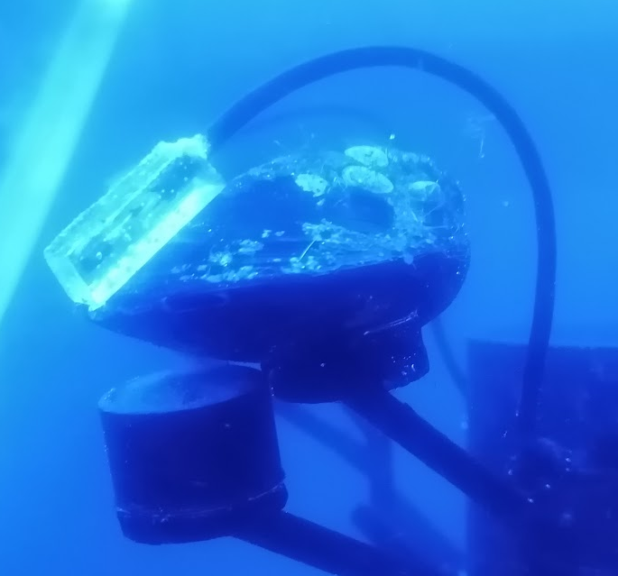


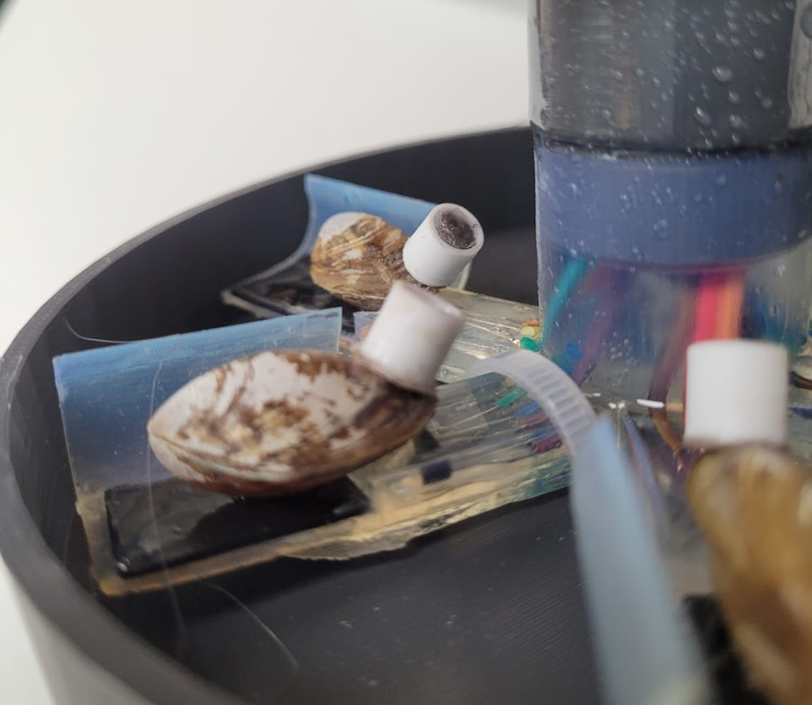
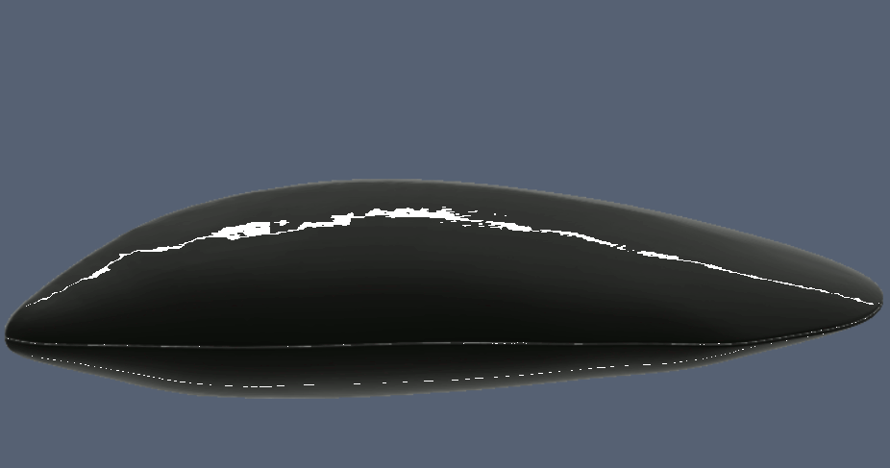
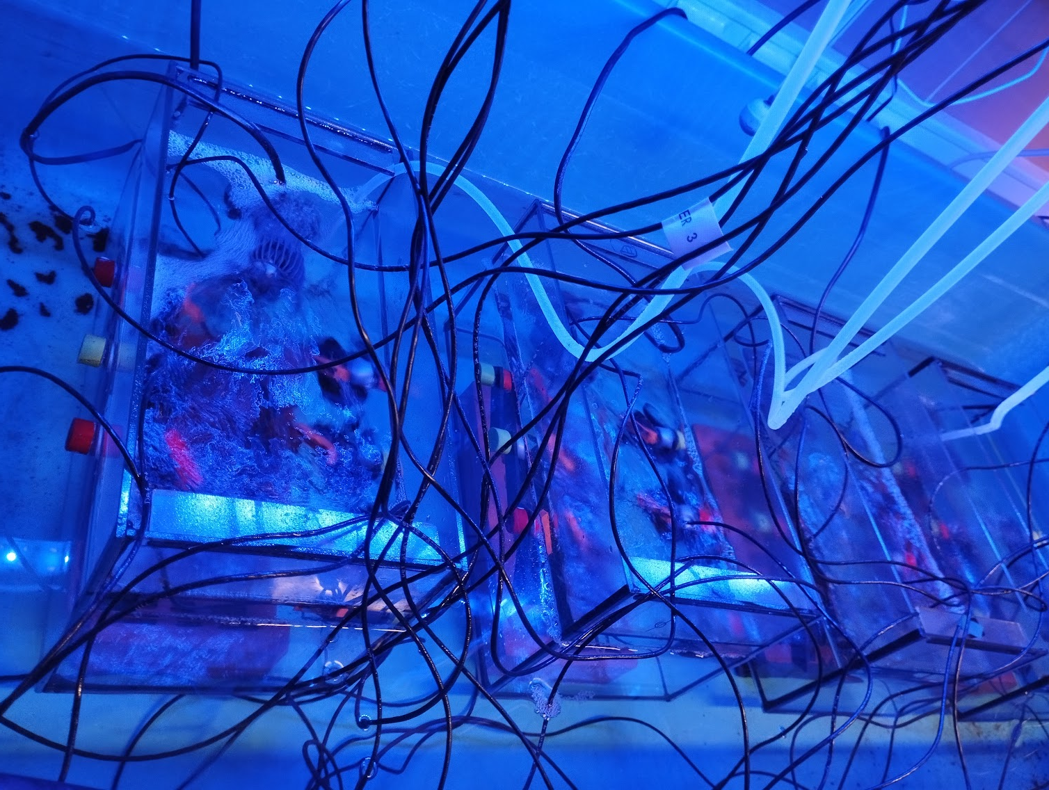

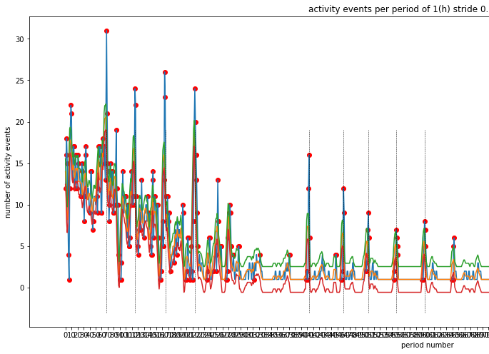


alvometry
in Mercur-Food
Why ?
How ?
Data analysis

Slide 2
Why : measurement of movement in sessile organisms ?
Behaviour as a biomarker of chemical pressure
  Behaviour responses reflect combination of cumulative effects engaging different pathays
    Affecting separately or together metabolism, endocrine, immune or nervous systems
  can be 10-100 times more sensitive than sublethal parameters ^{1,2}
  well suited to whole-organism continuous non-invasive bio-logging
  Useful to to built large scale distributed and low-cost high-frequence biological early-warning systems based on stress response in aquatic organisms
Valvometry to detect disturbed behaviours
  Bivalves are known to open and close their valves physiologically, in natural conditions
  Cyclic valve gaping is linked firstly to water inhalation for respiration and feeding (filtration), excretion (pseudofeces) and gamete release into water (spawning)
  Valve closure is also known as a protective response to stress in the presence of chemical toxicants, toxic algae, parasite infections, salinity decrease or heat increase³ – AVOIDANCE BEHAVIOUR
  Valvometry has already been used in freshwater and marine mussels
  Effect of Hg on valve behaviour is mostly unknown in Mytilus and Dreissena but neuromuscular system is affected by Hg intoxication in most species
Robinson, Peter D. 2009. “Behavioural Toxicity of Organic Chemical Contaminants in Fish: Application to Ecological Risk Assessments (ERAs).” Edited by Deborah MacLatchy. Canadian Journal of Fisheries and Aquatic Sciences 66 (7): 1179–88. https://doi.org/10.1139/F09-06
Hasenbein, Simone, Sharon P. Lawler, Juergen Geist, and Richard E. Connon. 2015. “The Use of Growth and Behavioral Endpoints to Assess the Effects of Pesticide Mixtures upon Aquatic Organisms.” Ecotoxicology 24 (4): 746–59. https://doi.org/10.1007/s10646-015-1420-1.
Andrade, Hector, Jean-Charles Massabuau, Sabine Cochrane, Pierre Ciret, Damien Tran, Mohamedou Sow, and Lionel Camus. 2016. “High Frequency Non-Invasive (HFNI) Bio-Sensors As a Potential Tool for Marine Monitoring and Assessments.” Frontiers in Marine Science 3 (October). https://doi.org/10.3389/fmars.2016.00187.

Slide 3
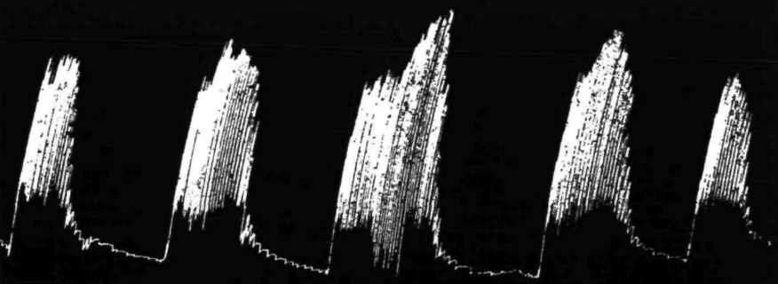
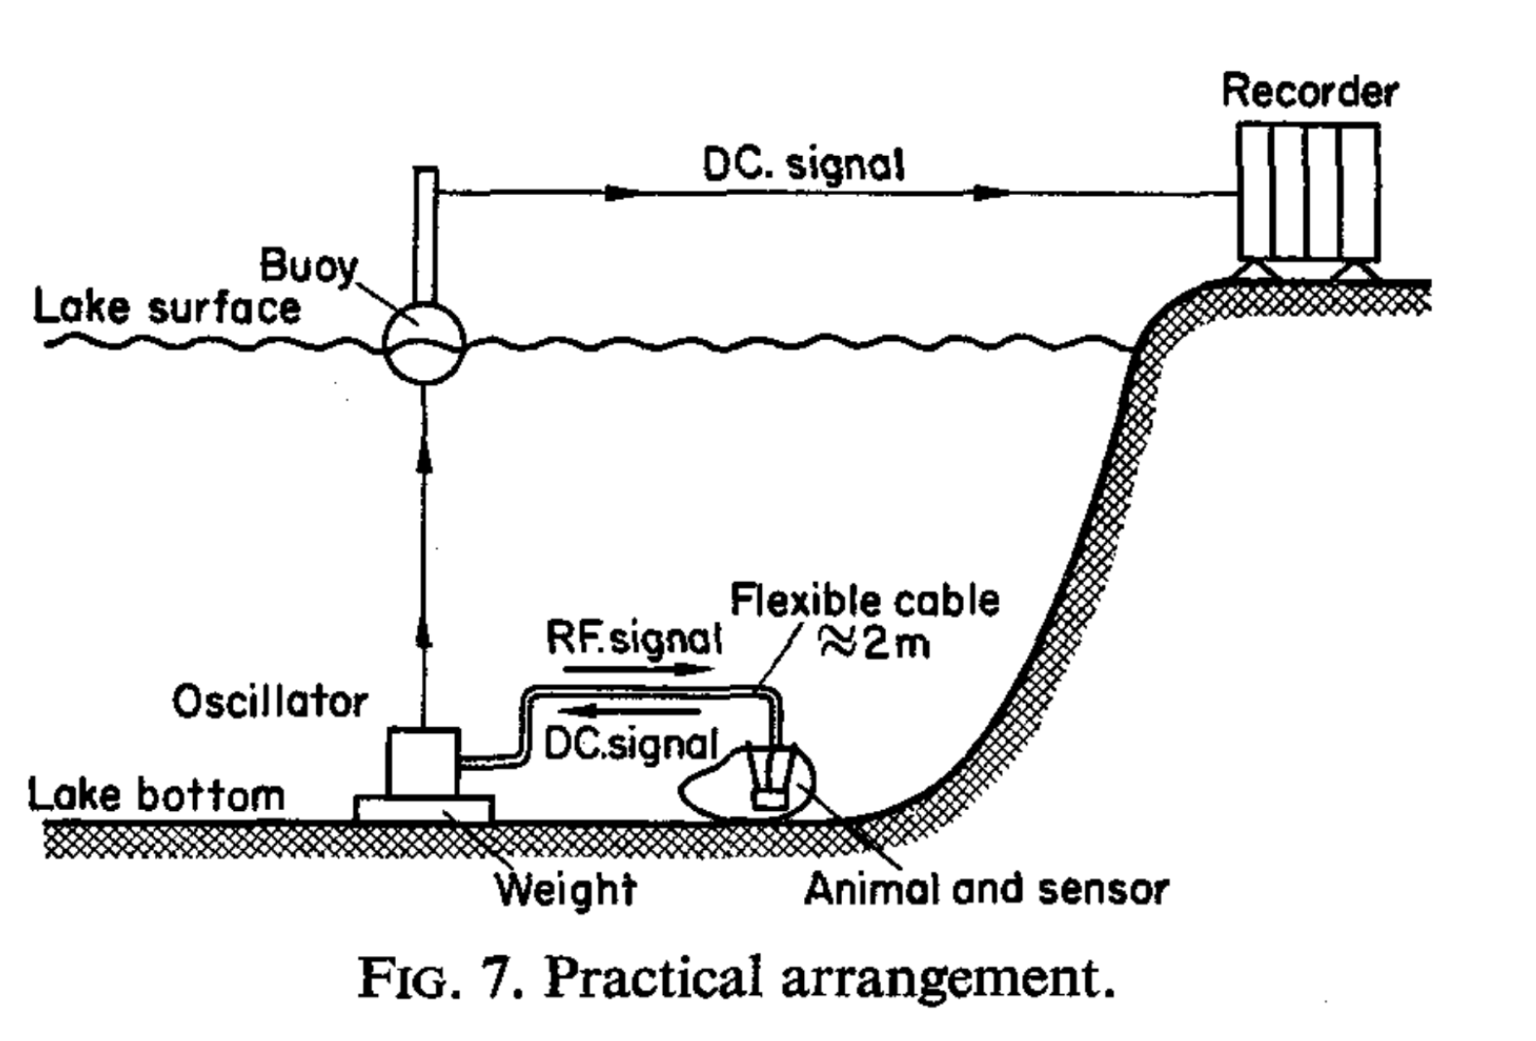
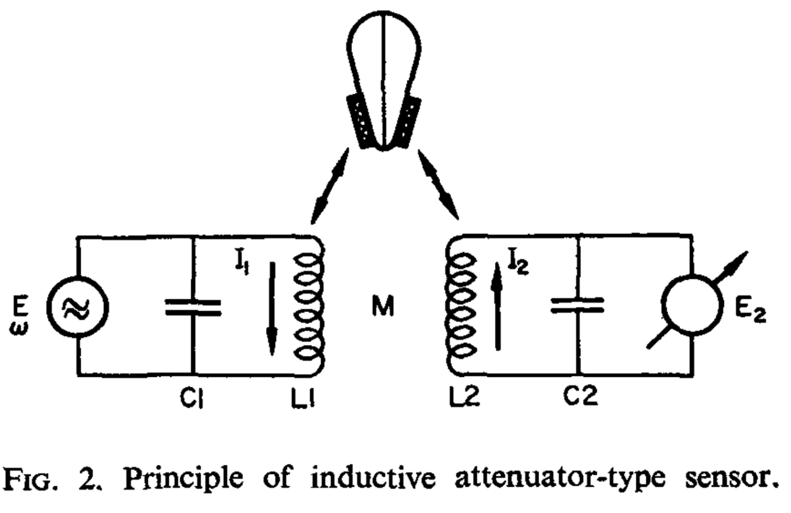
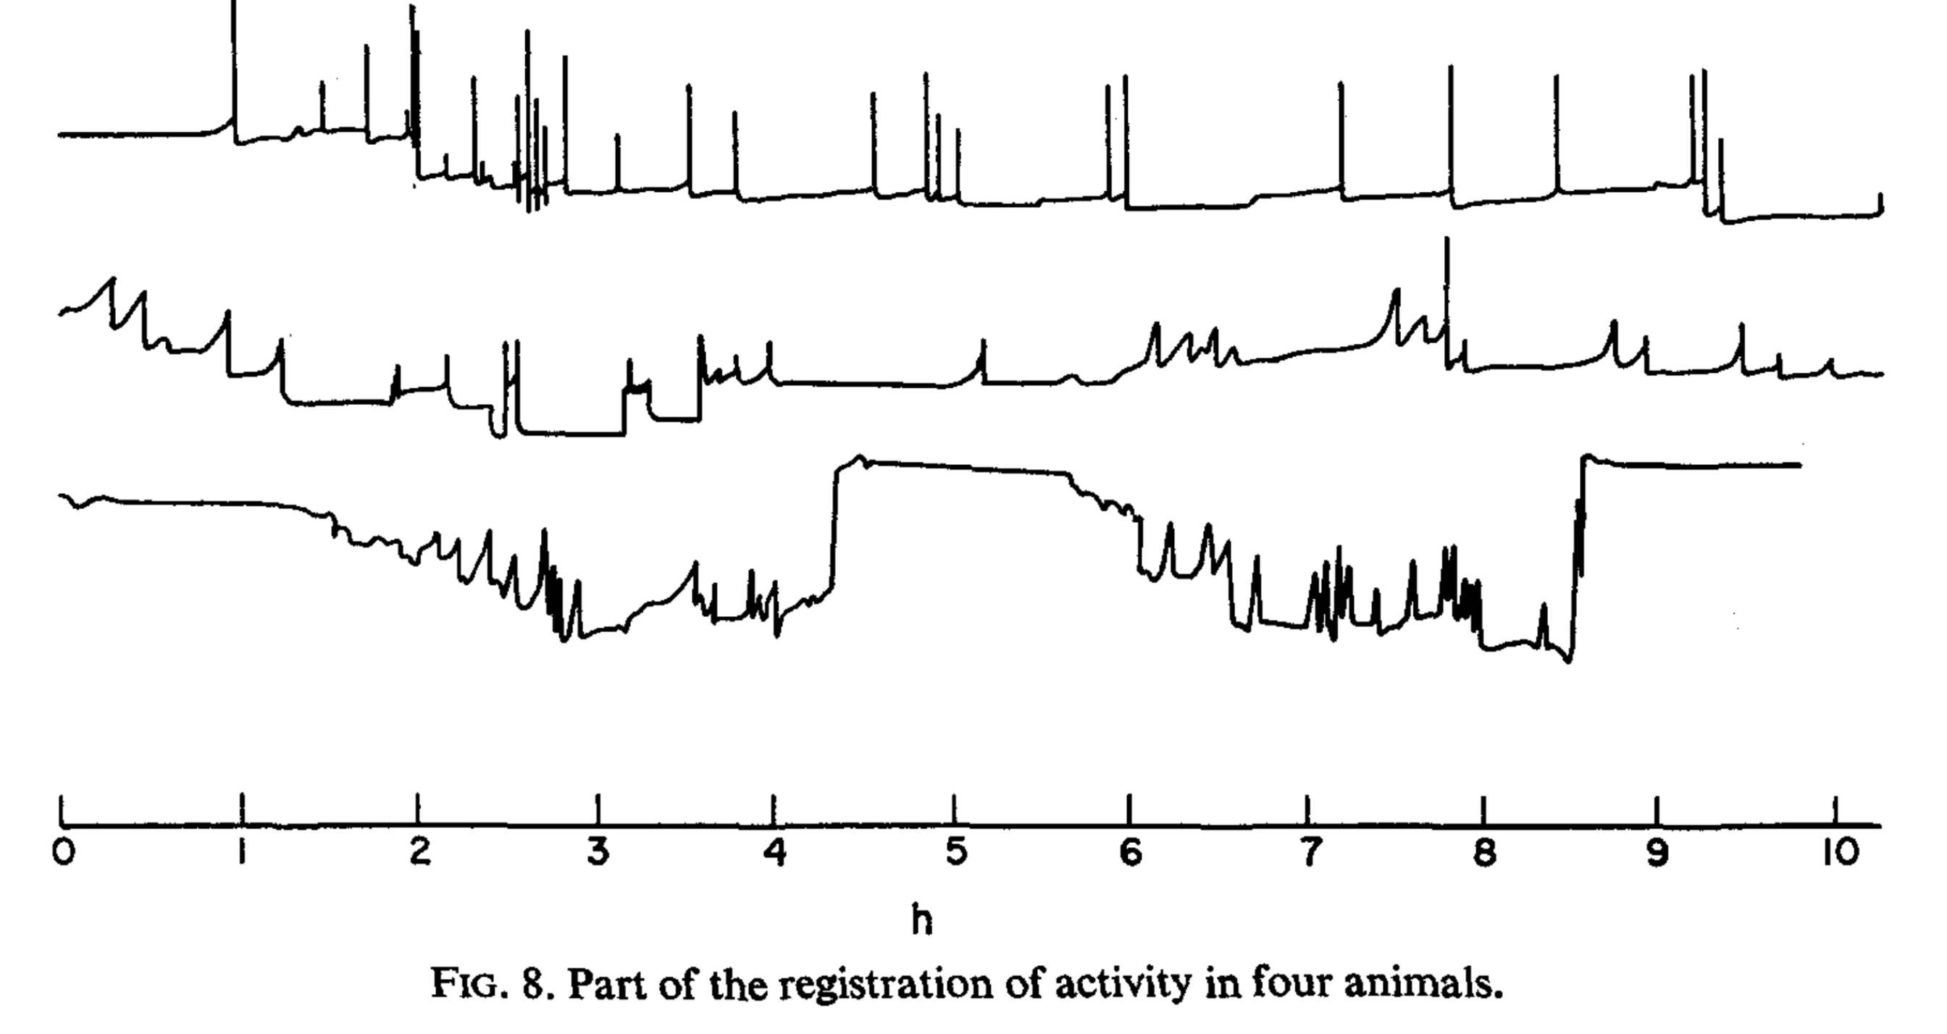
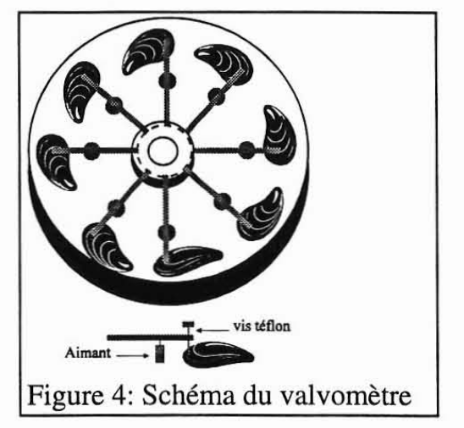
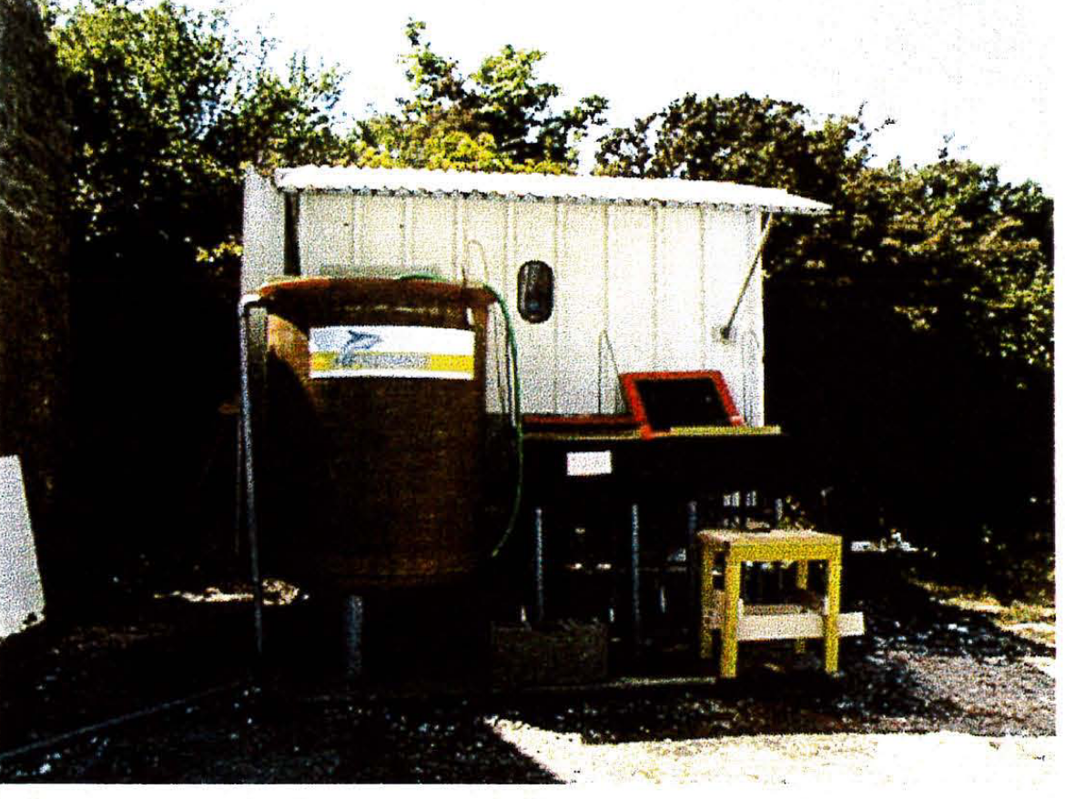
Brief history of valvometry
Date | Titre | Bivalve | Auteur | Méthode | Contaminants
1955 | The behaviour of Anondonta cygnea L. and its neurophysiological basis | Anondonta cygnea L. | G.E. Barnes | mechanical
1969 | Inductive attenuator for continuous registration of rythmic and periodic activity of mussels in their natural environment | not given ! | Véro and Salanki | coil-coil
1983 | Detection Limits of a Biological Monitoring System for Chemical Water Pollution Based on Mussel Activity | Dreissena polymorpha | W. Sloof et al. | coil-coil HFO | Cd, Cu, cyanure, chloroforme, benzene, toluene…
1989 | The valve movement response of mussels: a tool in biological monitoring | Dreissena polymorpha & Mytilus edulis | K.J.M. Kramer et al. | coil-coil HFO | Cu, Cd, Se, Zn, Pb, TBTO, hypoclorite
1994 | The “Dreissena-Monitor” - First Results on the Application of this Biological Early Warning System in the Continuous Monitoring of Water Quality | Dreissena polymorpha | J. Borcherding | interrupteur magnétique ON-OFF | Pentochlorophenol
1997 | Shell valve movement response of dark false mussel, mytilopsis leucophaeta, to chlorination | Mytiliopsis leucophaeta | S. Rajacopal et al. | coil-coil HFO | hypoclorite
1999 | Systeme expérimental de surveillance biologique de la qualité de l'eau par des Huîtres (Crassostrea gigas) et des moules (Mytilus edulis) | Crassostrea gigas & Mytilus edulis | J.F. Bouget et al. | Mécanique-Hall
2003 | Estimation of potential and limits of bivalve closure response to detect contaminants: Application to cadmium | Corbicula fluminea | D. Tran et al. | coil-coil HFO | Cd
2004 | Copper detection in the Asiatic clam Corbicula fluminea: optimum valve closure response | Corbicula fluminea | D. Tran et al. | coil-coil HFO | Cu
2006 | Ten years of practical experience with the Dreissena-Monitor, a biological early warning system for continuous water quality monitoring | Dreissena polymorpha | J. Borcherding | interrupteur magnétique ON-OFF | Cu, Cd, Se, Zn, Pb, TBTO, hypoclorite…
2006 | Valve movement response of the mussel Mytilus galloprovincialis to metals (Cu, Hg, Cd and Zn) and phosphate industry effluents from Moroccan Atlantic coast | Mytilus galloprovincialis | M. Ait Fdil et al. | Ferrite-inductance | Cu, Hg, Cd, Zn
2007 | Inorganic mercury detection by valve closure response in the freshwater clam Corbicula fluminea: Integration of time and water metal concentration changes | Corbicula fluminea | D. Tran et al. | coil-coil HFO | Hg
2007 | Influence of the parasite worm Polydora sp. on the behaviour of the oyster Crassostrea gigas: A study of the respiratory impact and associated oxidative stress | Crassostrea gigas | C. Chambon et al. | coil-coil HFO | Polydora sp.
2011 | In situ giant clam growth rate behavior in relation to temperature: A one-year coupled study of high-frequency noninvasive valvometry and sclerochronology | Hippopus hippopus | C. Schwartzmann et al. | coil-coil HFO
2011 | Water quality assessment by means of HFNI valvometry and high-frequency data modeling | Crassostrea gigas | M. Sow et al. | coil-coil HFO
2011 | Effects of Cypermethrin (Pyrethroid Insecticide) on the Valve Activity Behavior, Byssal Thread Formation, and Survivalin Air of the Marine Mussel Mytilus galloprovincialis | Mytilus galloprovincialis | M. Ait Ayad et al. | Détecteur inductif | Cypermethrin
2011 | Statistical study of bivalve high frequency microclosing behavior: scaling properties and shot noise analysis | Crassostrea gigas | F. Schmitt et al. | coil-coil HFO
2012 | A real-time biomonitoring system to detect arsenic toxicity by valve movement in freshwater clam Corbicula fluminea | Corbicula fluminea | W.S. Chen et al. | Effet Hall | As
2013 | Synthesis and measurement of valve activities by an improved online clam-based behavioral monitoring system | Corbicula fluminea | W.S. Chen et al. | Effet Hall
2014 | A hidden renewal model for monitoring aquatic systems biosensors | analyse | R. Azais et al.
2016 | High frequency non-invasive (HFNI) bio-sensors as a potential tool for marine monitoring and assessments | revue | H. Andrade et al.
2016 | In situ spawning in a marine broadcast spawner, the Pacific oyster Crassostrea gigas: Timing and environmental triggers | Crassostrea gigas | I. Bernard et al. | coil-coil HFO
2017 | Valve gape behaviour of mussels (Mytilus edulis) exposed to dispersed crude oil as an environmental monitoring endpoint | Mytilus edulis | K.J. Redmond et al. | Laser | pétrole brut
2017 | The sense of hearing in the Pacific oyster, Magallana gigas | Magallana gigas | M. Charifi et al. | coil-coil HFO | son
2019 | PSP-producing dinoflagellate Alexandrium minutum induces valve microclosures in the mussel Mytilus galloprovincialis | Mytilus galloprovincialis | L.A. Comeau | Effet Hall | toxine
First valve activity recorded ever (Barnes, 1955)
First electronic valvometer (Véro and Salanki, 1969)
Electro-mechanical valvometer (IFREMER, 1999)

Slide 4


How : iCageTM valvometers
Valvometry in Mercur-Food
  Individual valve movements with a small Hall effect sensor and a neodymium magnet sticked on one valve
  The magnetic field varies as 1/d² of the gaping space and monitors the valve activity (basically frequence and amplitude of valve movements)
  In the IcageTM design, valvometers are seen as nodes collecting valve activity of small population of mussels (typically 6 to 12) exposed in a defined environment
  The physical signal is conditionned, transmitted to Data server, stored in database
PostGRE
Node
biosensor
Signal conditionner
ARDUINO
ADC
Rpi Icaging95 IP 192.X.X.X
/DATA
JSON (C1…C6 TimeStamp)
RSYNC
serial
script
Pil-86
Local server
/DATA/
File format & metadata cms
Icaging95-BP-2024-10-10.csv
Rpi Icaging97
…….
RPi
Sas Quinette, Beaujival…
4G
Sim
iCagingDATA
Cloud virtual host

Slide 5
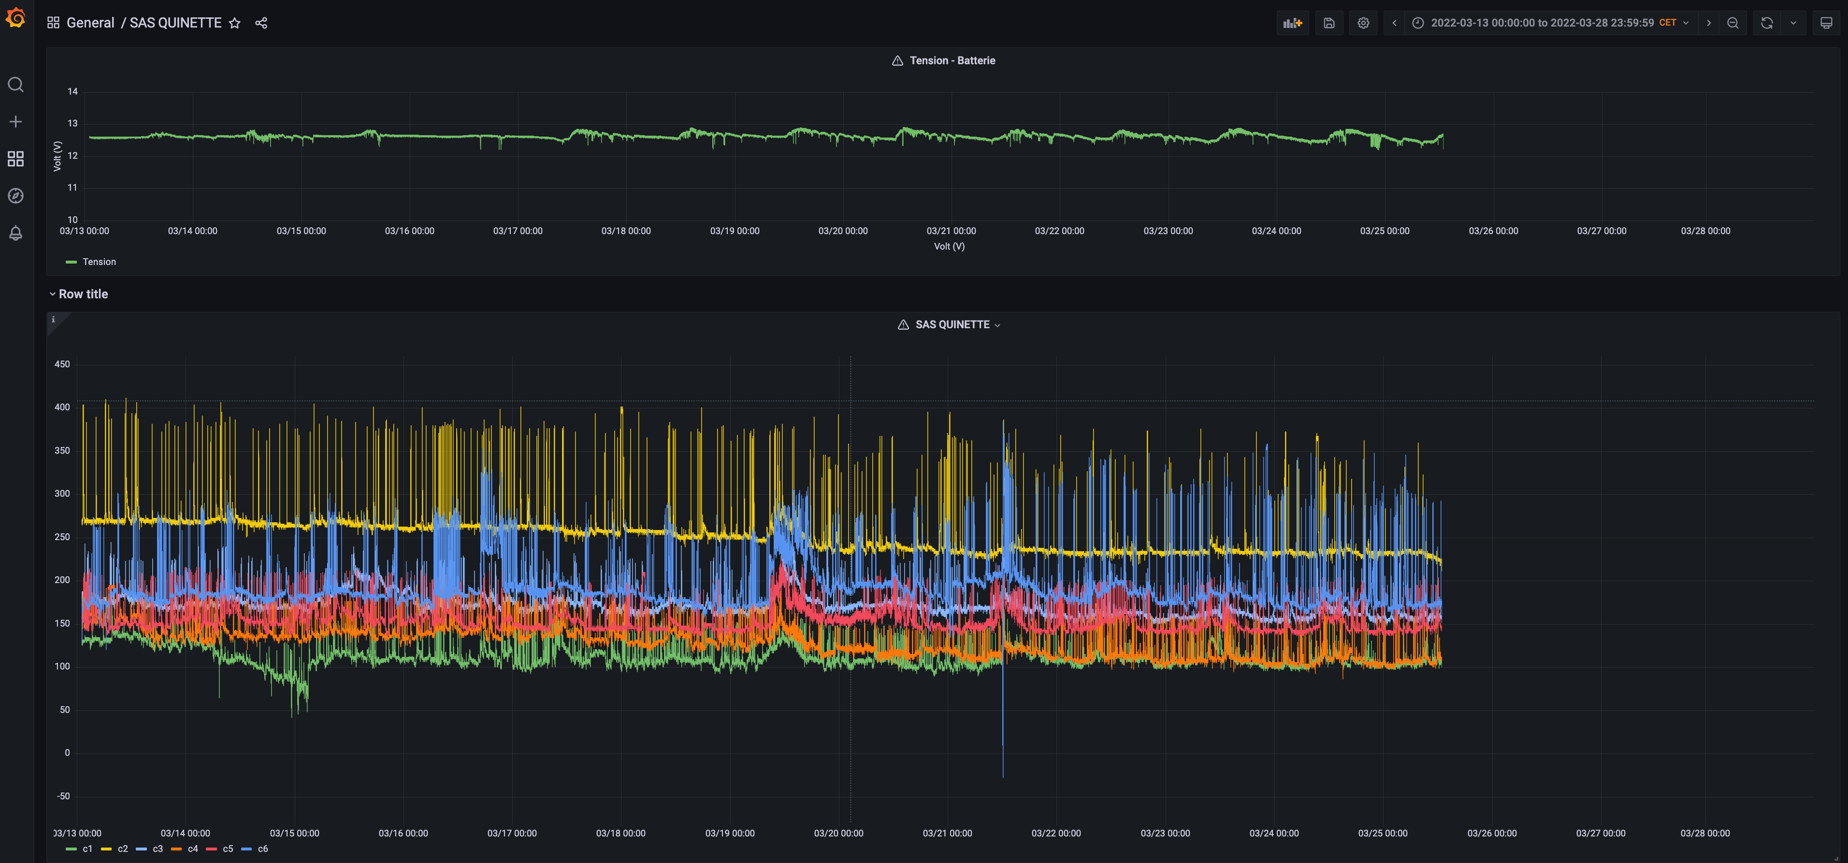
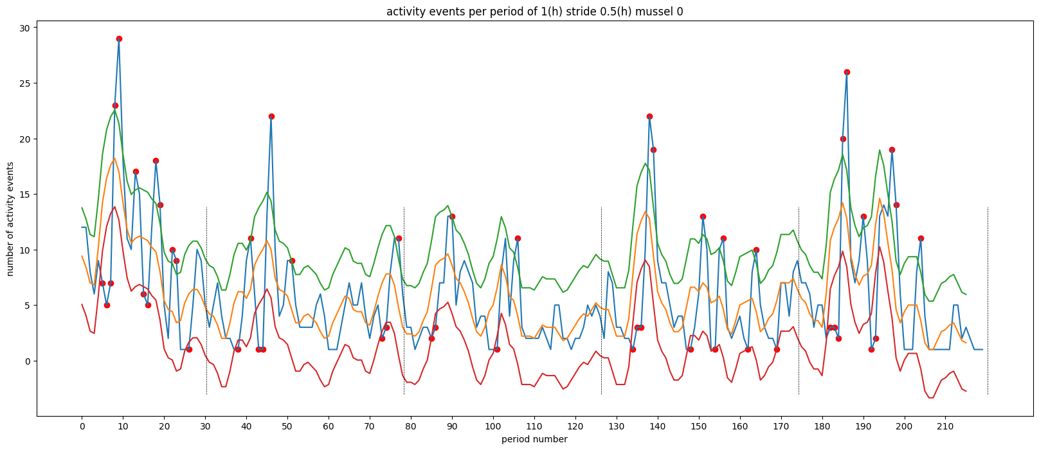
How : iCageTM valvometers
Valvometry in Mercur-Food
  Raw data are pre-processed and analyzed by cloud computing algorythms
Grafana dashboard
PostGRE
visualization
DATA pre-processing
Python code
Analysis plot
1- aggregation 10 sec – 1 min
2- linearization
3- inversion
4- cleaning out of range values
5- data gap filling
6- normalization of valve opening amplitude (%)
VOA = [(opening-min)/(max-min)]*100
DATA analysis
Python code

Slide 6
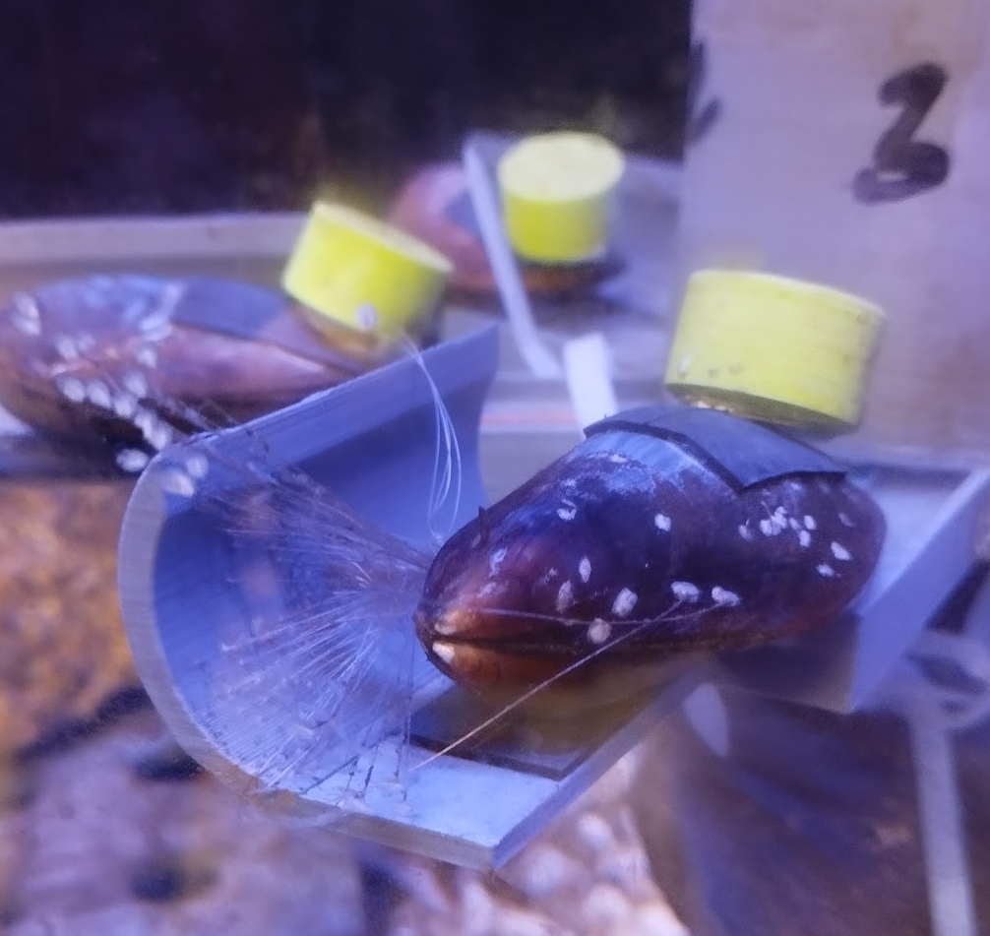
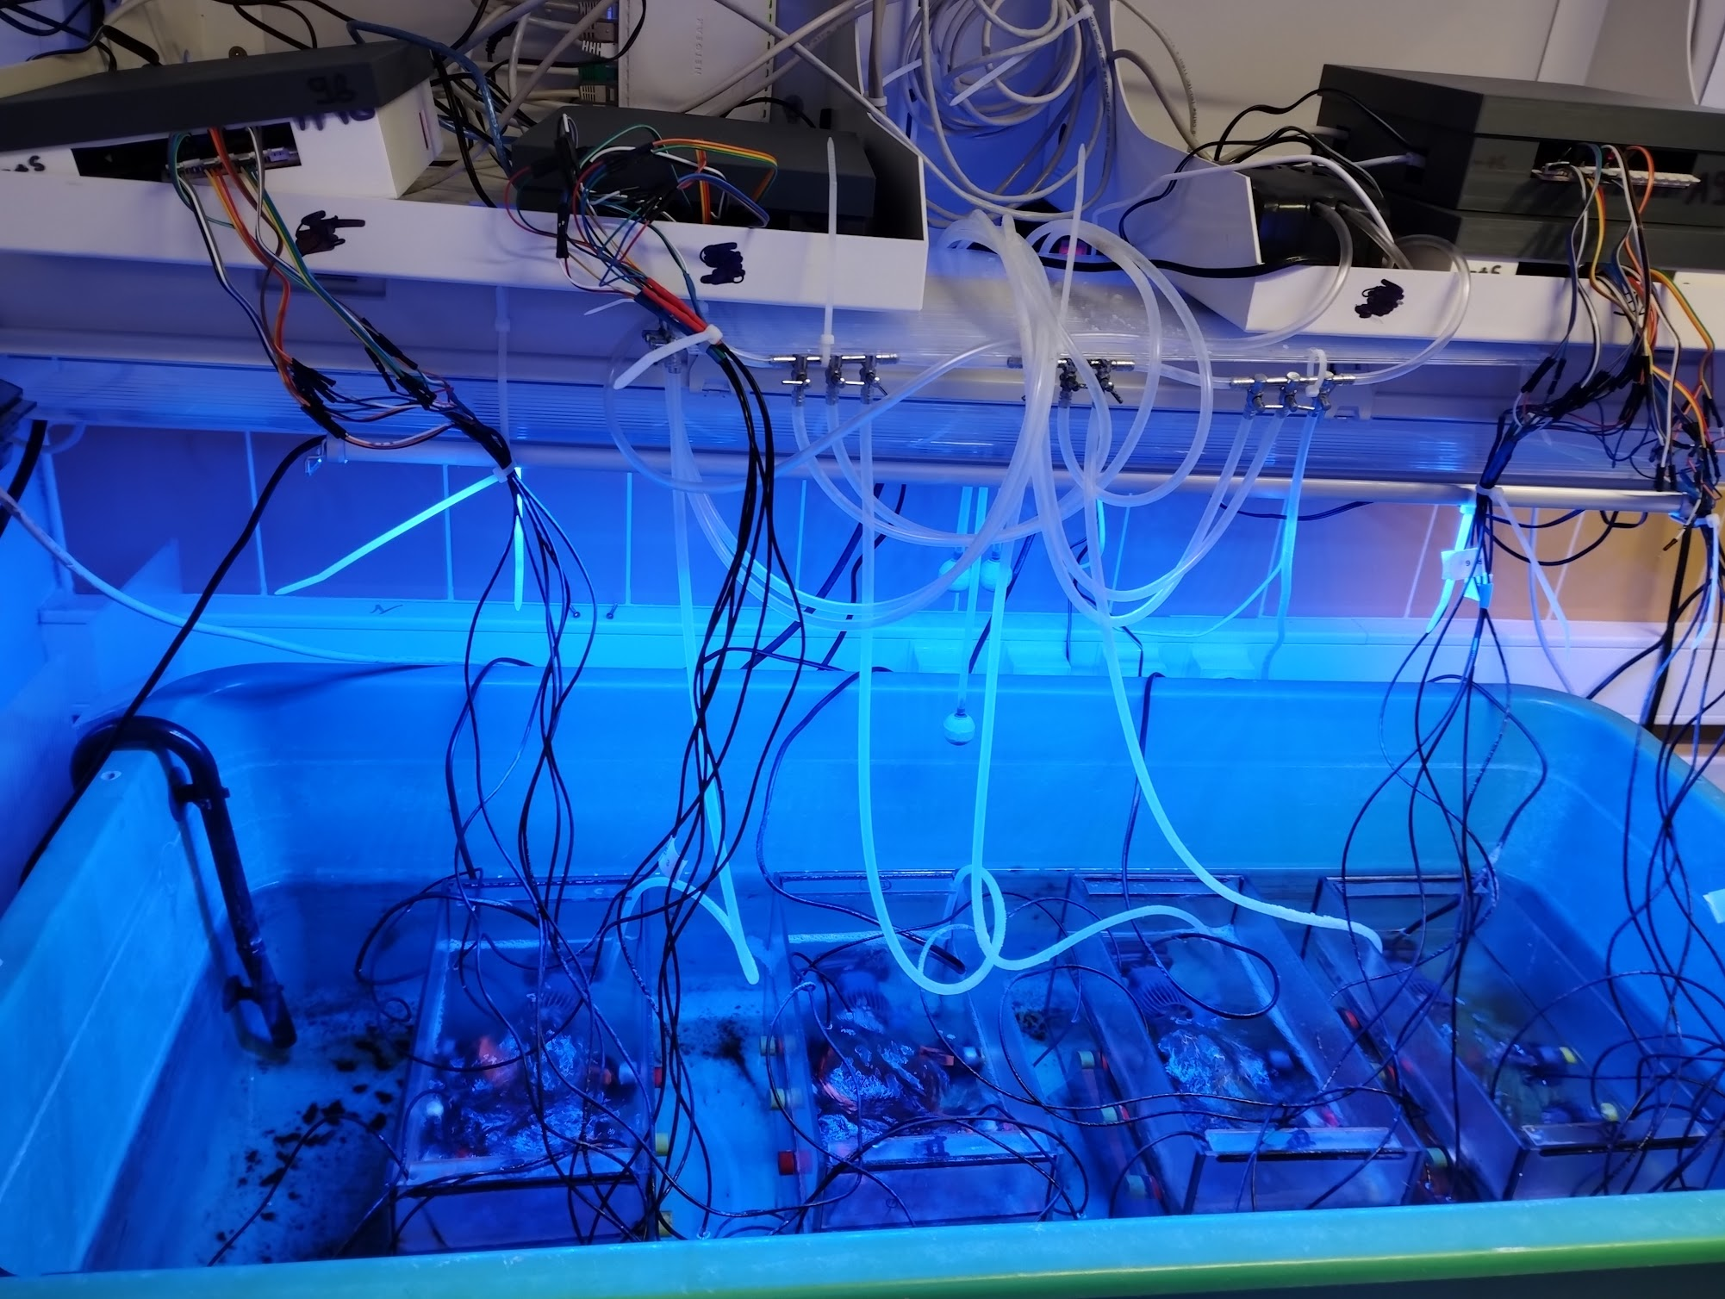
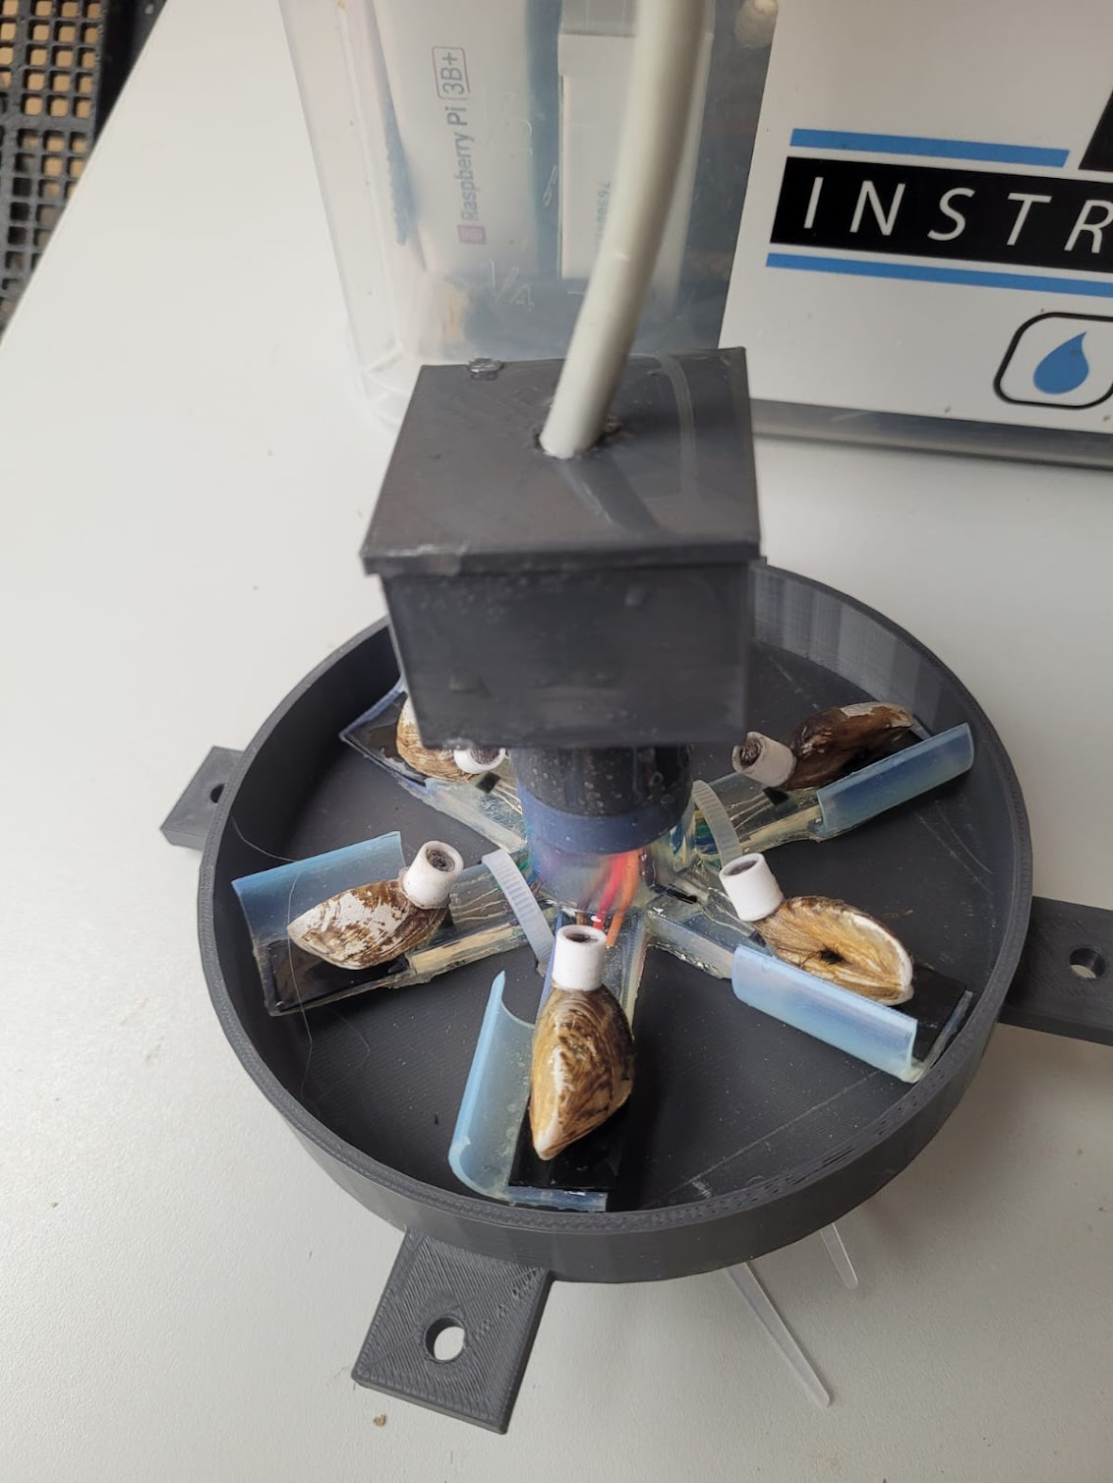
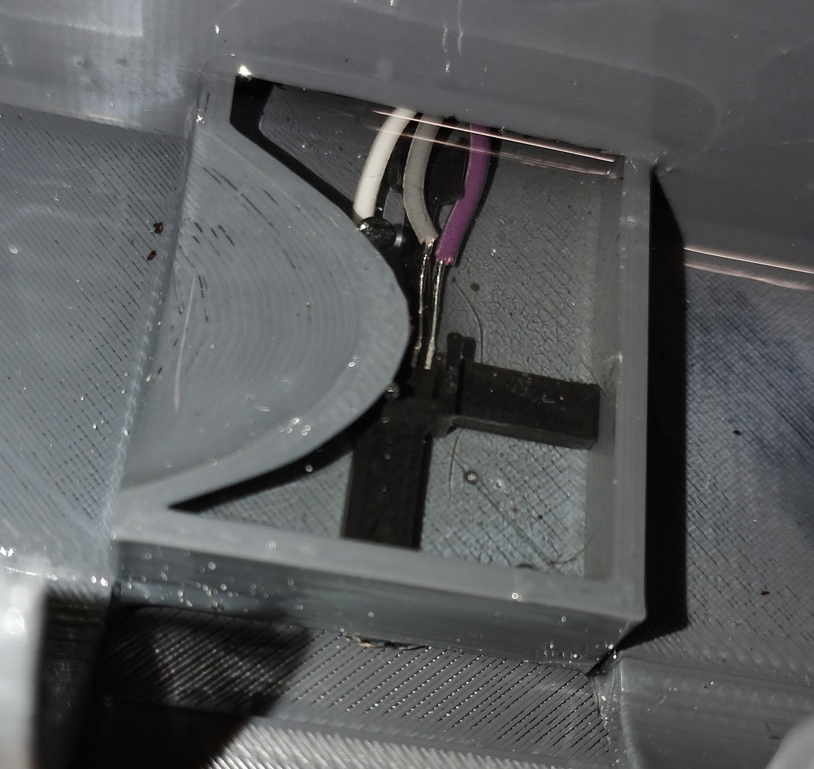
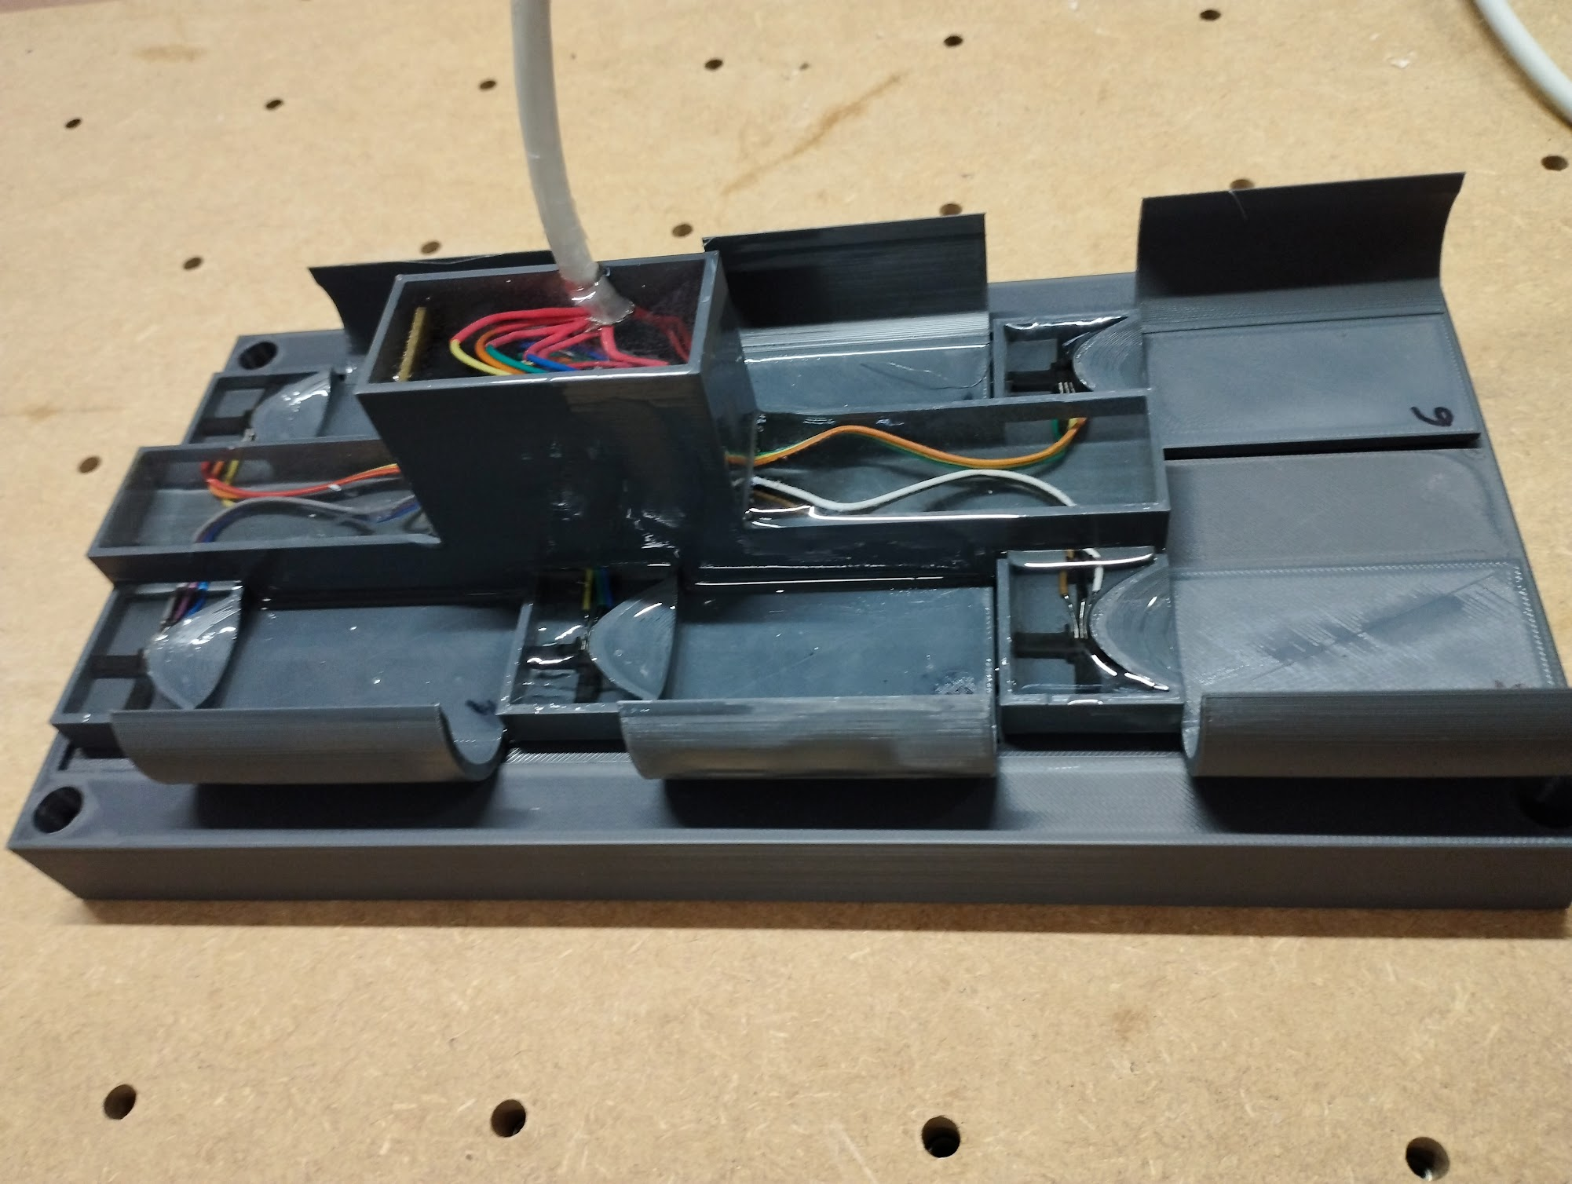
How : iCageTM valvometers
Detail of Byssus-friendly vertical surface
Valvometry in Mercur-Food
  IcageTM valvometers are developped as
      smart bioT (Biological internet of Things) sensors for field deployment
      lab bench water tank equipment for controlled laboratory experiments
Detail of sensor embedding in 3D-printed stage
Hexagonal Dreissena stage
Water bath temperature and day/night controlled lab bench valvometry
Parallel Mytilus stage

Slide 7
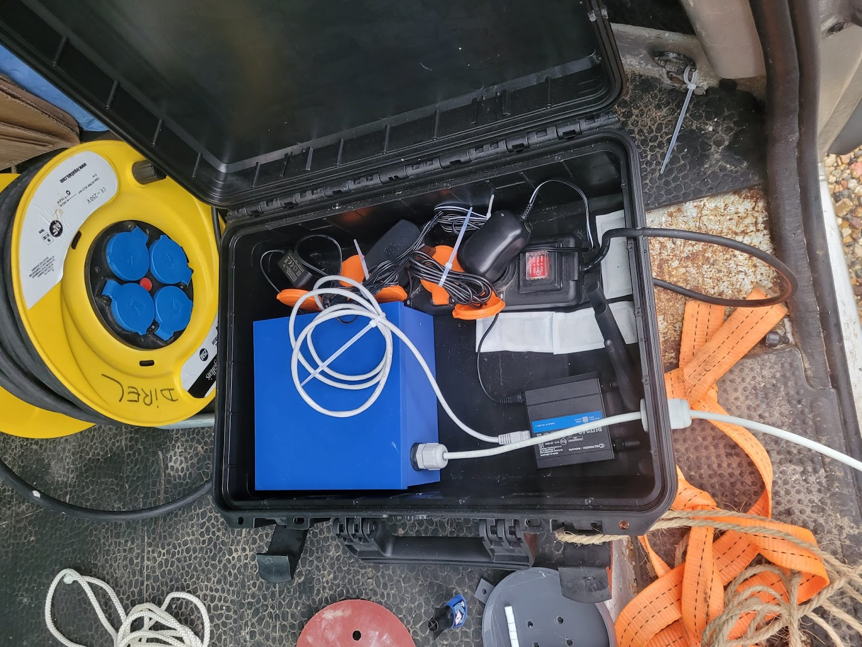
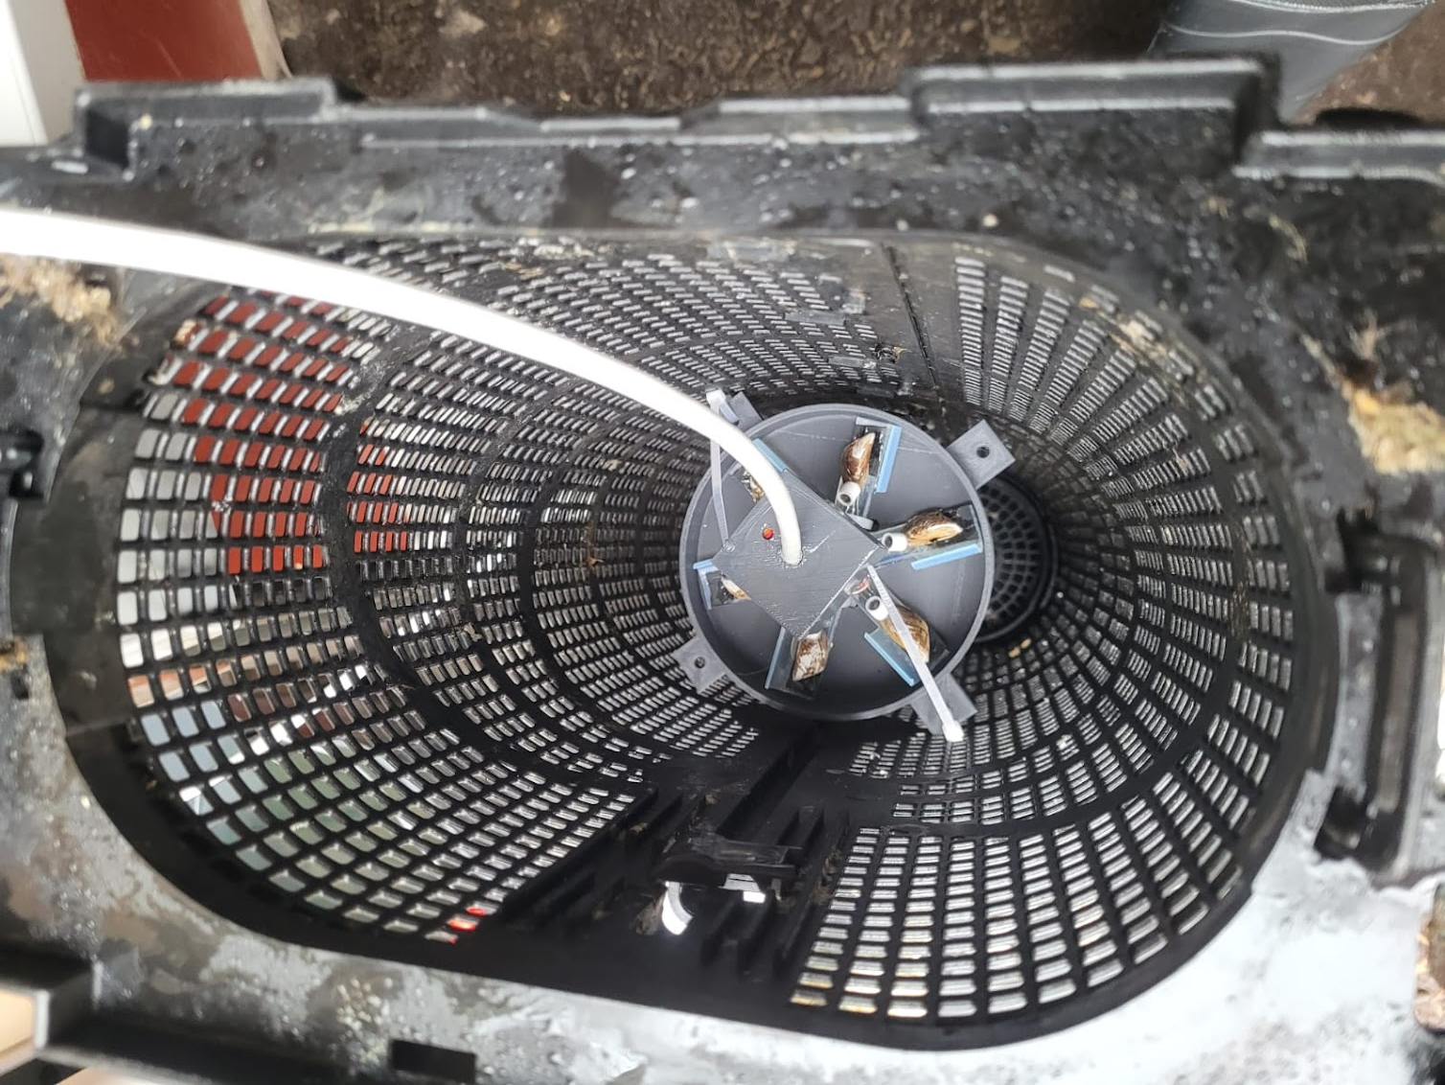
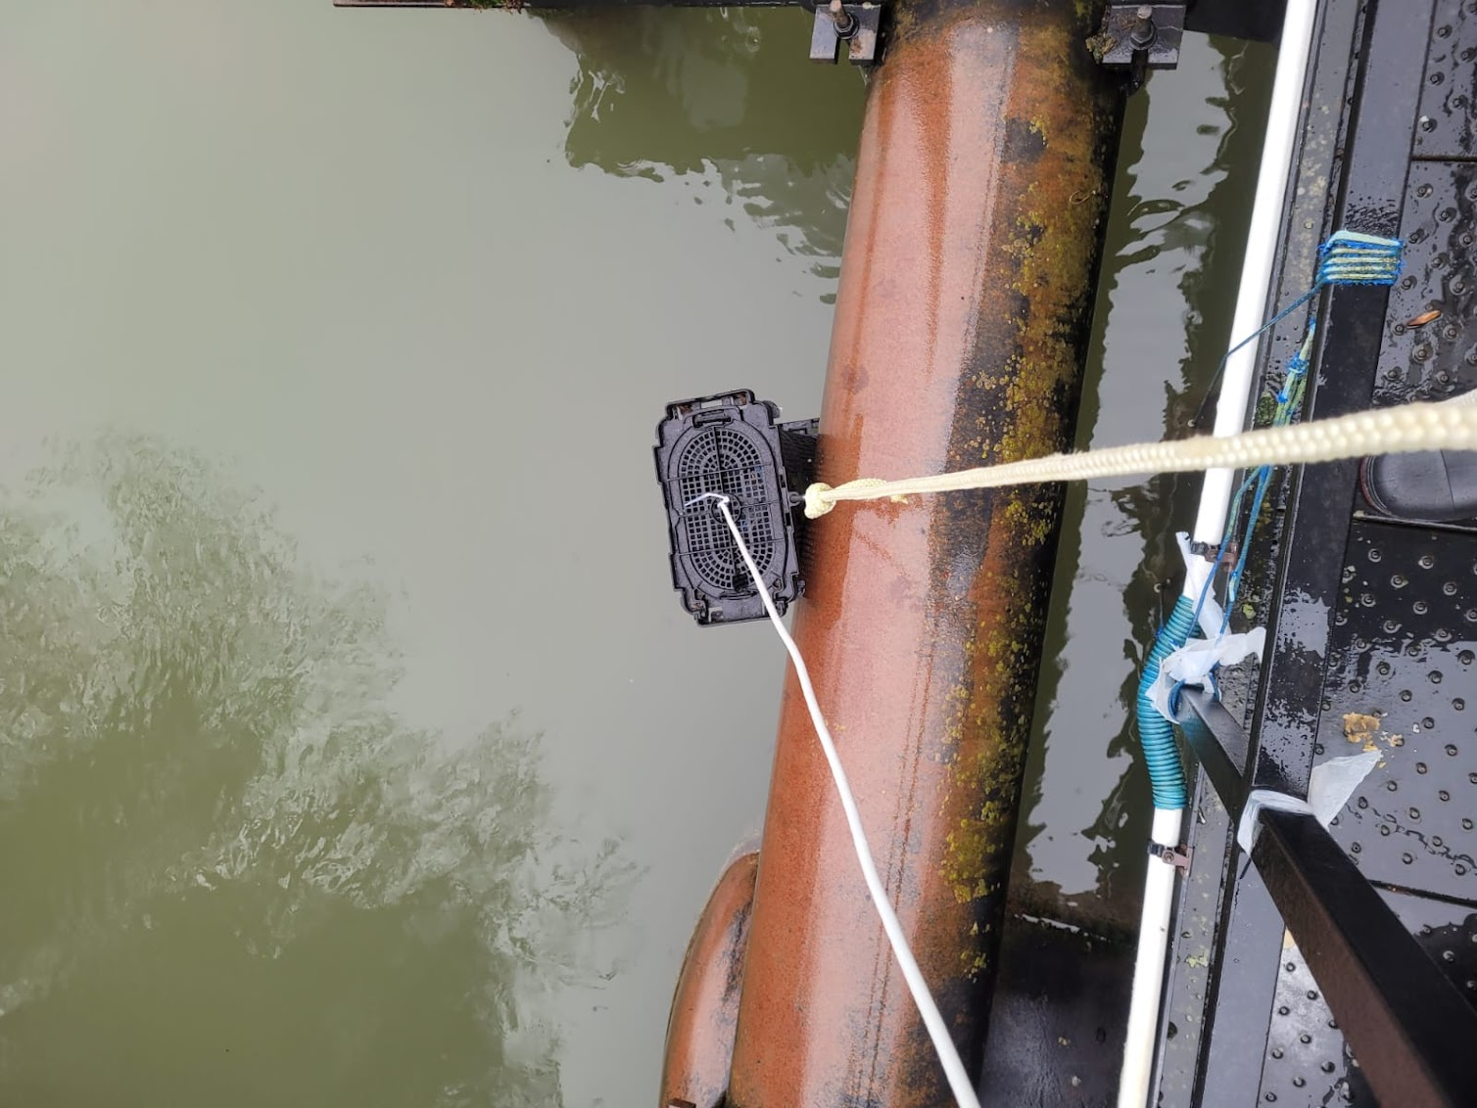
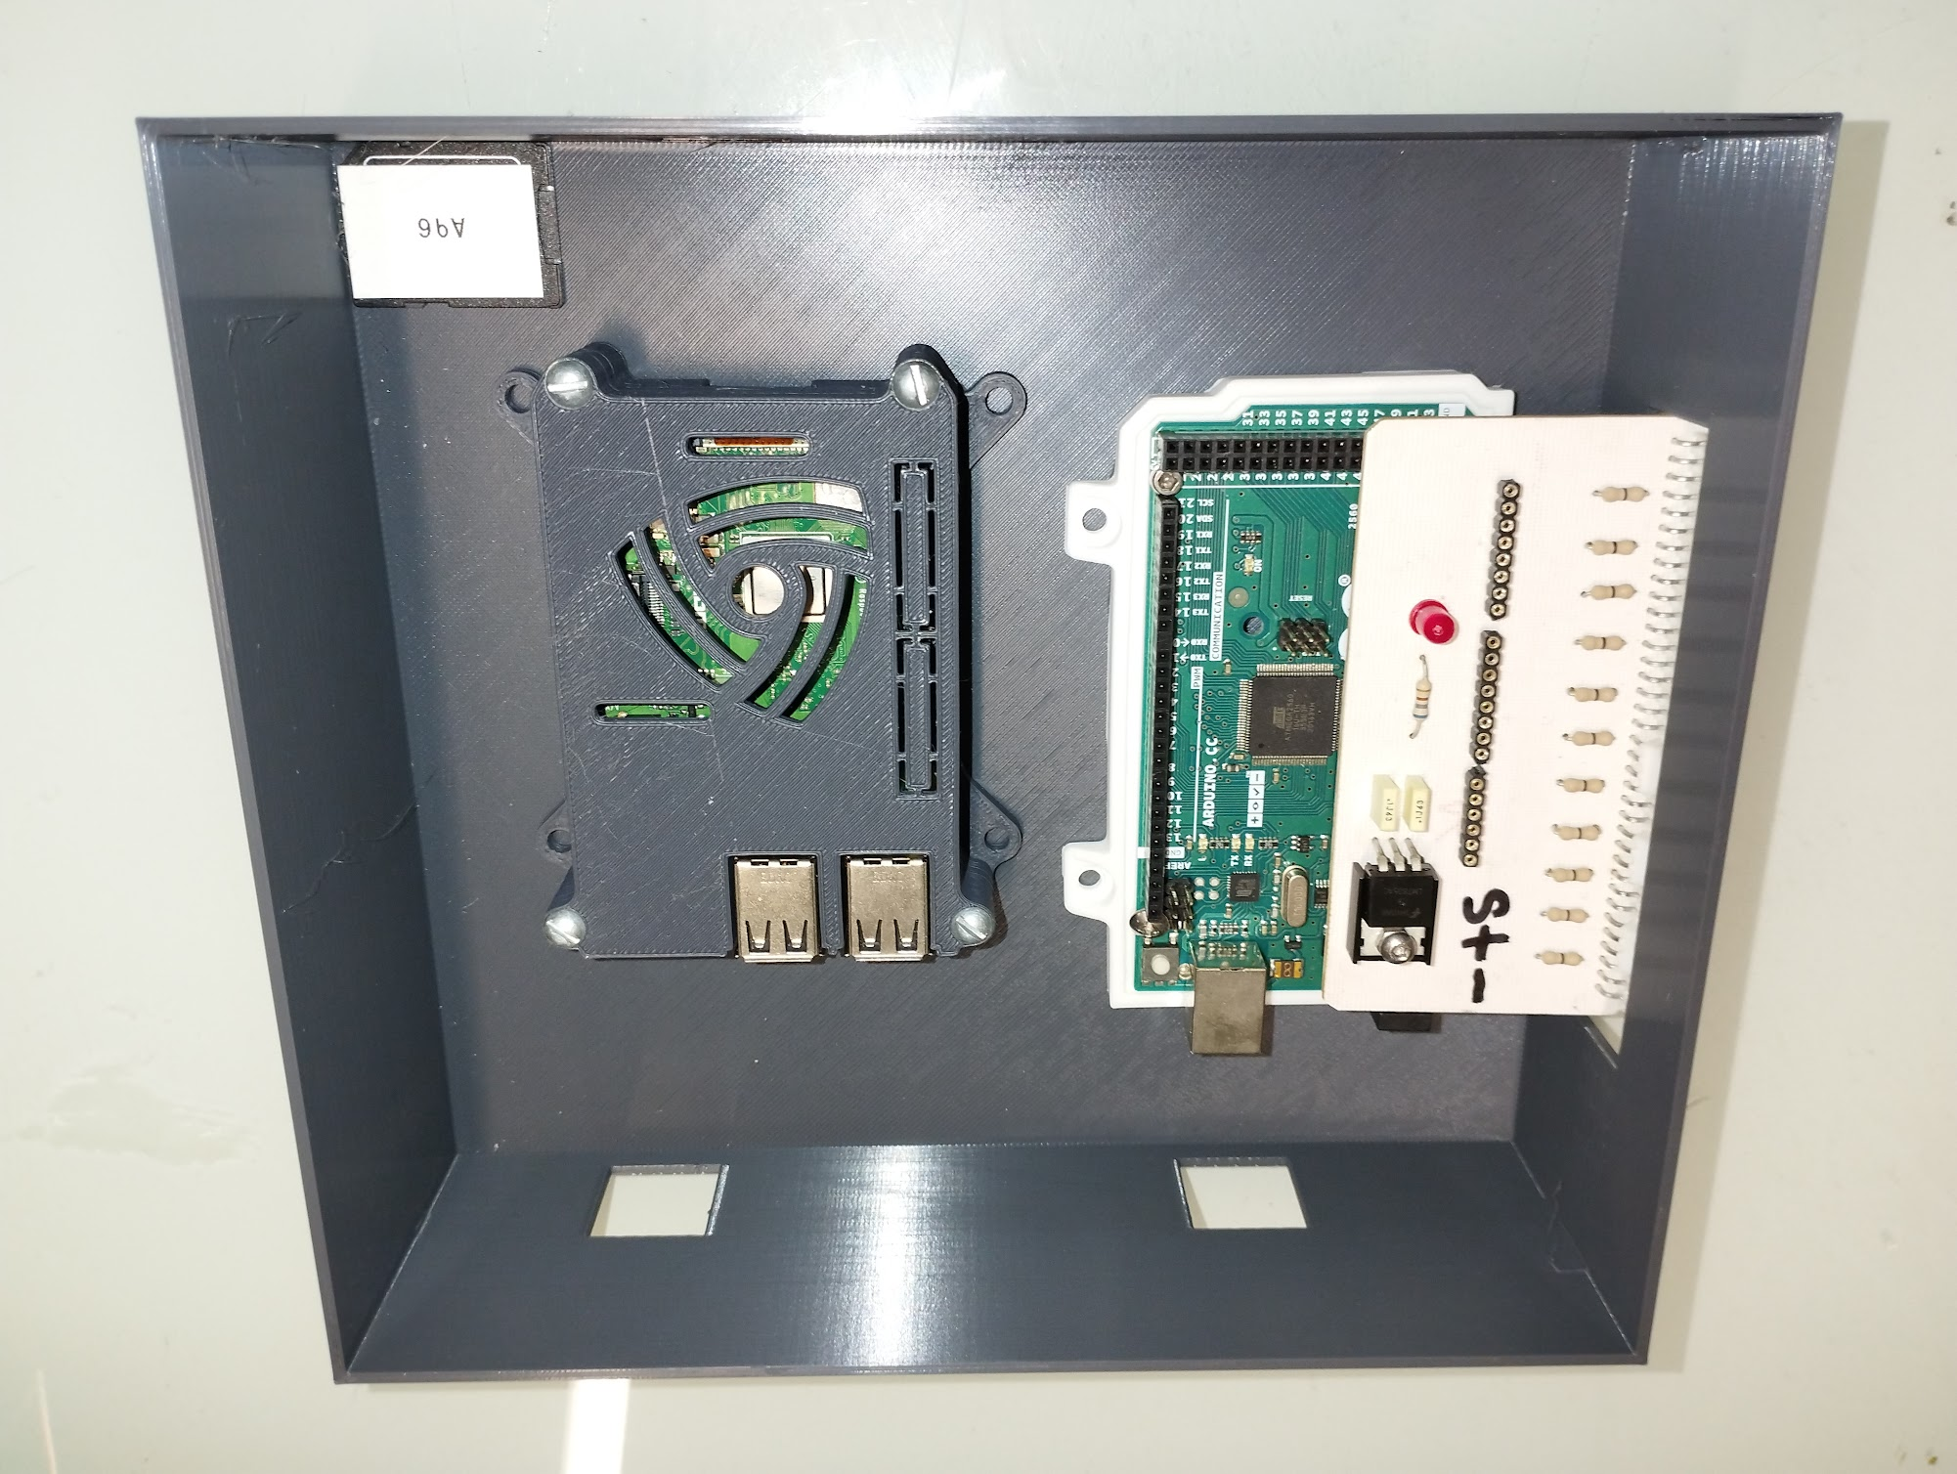
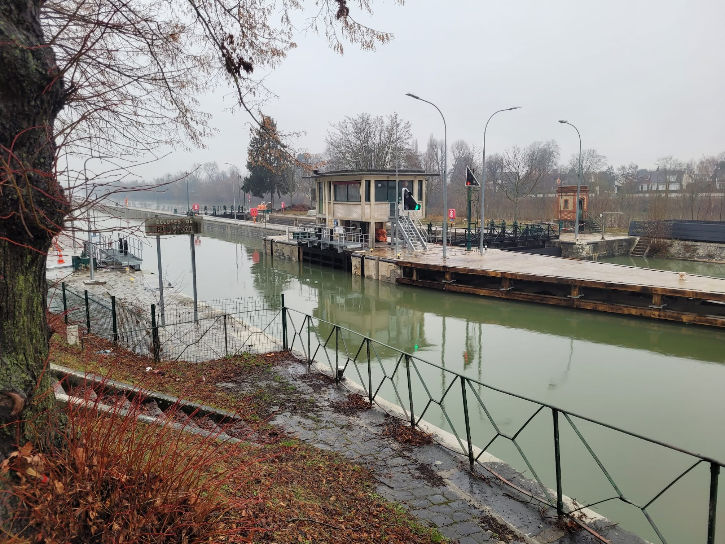
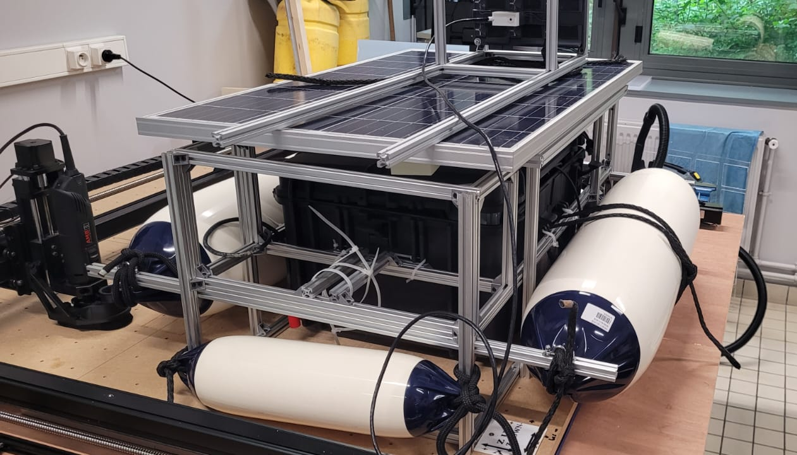
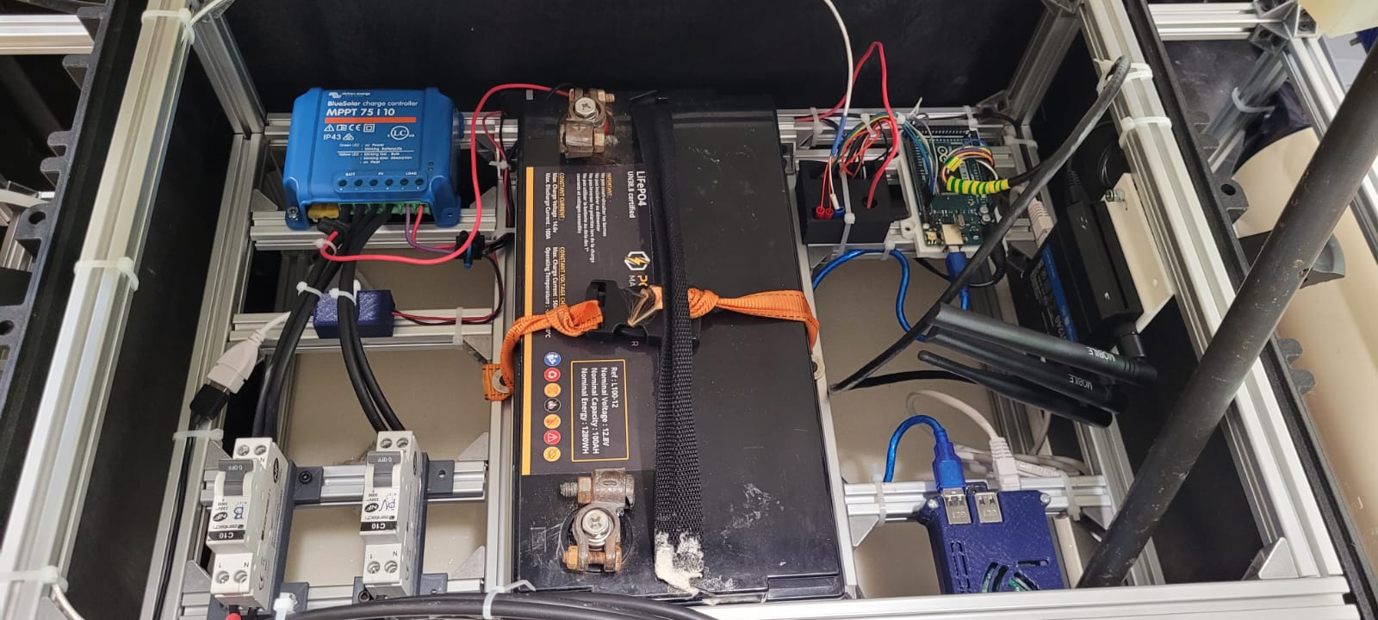
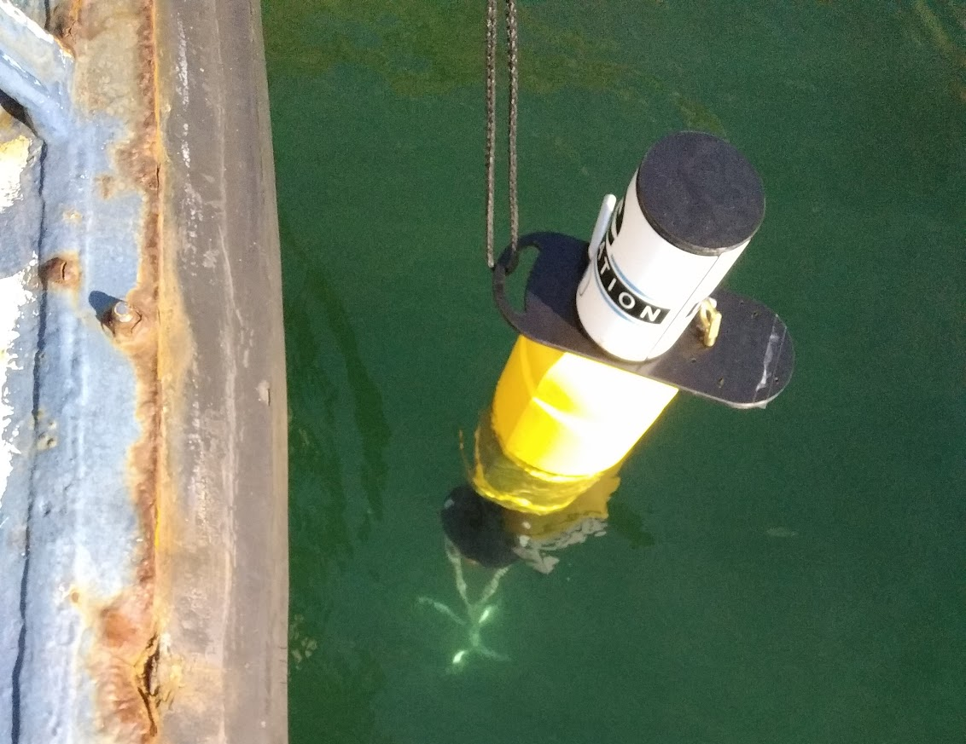
How : iCageTM valvometers
Valvometry in Mercur-Food
  IcageTM valvometers are developped as
      smart bioT (Biological internet of Things) sensors for field deployment
      lab bench water tank equipment for controlled laboratory experiments
Mains-powered Dreissena valvometer immersed at the Beaujival waste water treatment plant
Fully energy-communication autonomous Mytilus valvometric raft deployed with a NKE multiparametric probe in Le Havre harbor

Slide 8
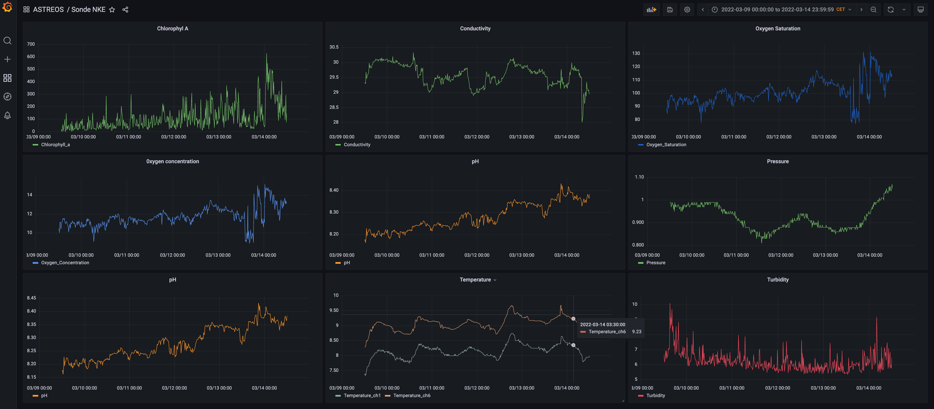
Data Analysis : Grafana visualization of NKE water parameters

Slide 9
Data Analysis : Grafana visualization of raw time series corresponding to a 12-hours valve activity recording of 6 marine mussels in immersed in Le Havre harbour (valve closures are in the upper part of the graph)

Slide 10
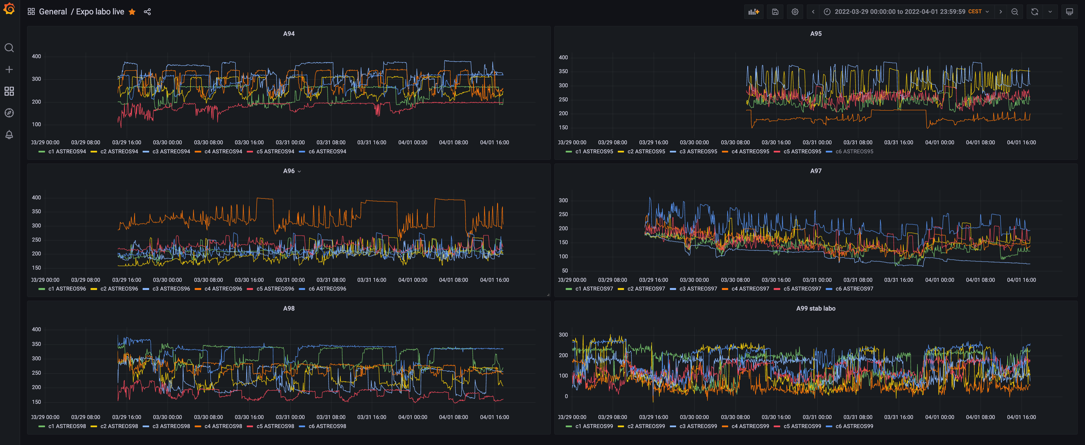
Data Analysis : Grafana visualization of 6 nodes of 6 mussels in a lab stabulation experiment (valve closures are in the upper part of the graph)

Slide 11
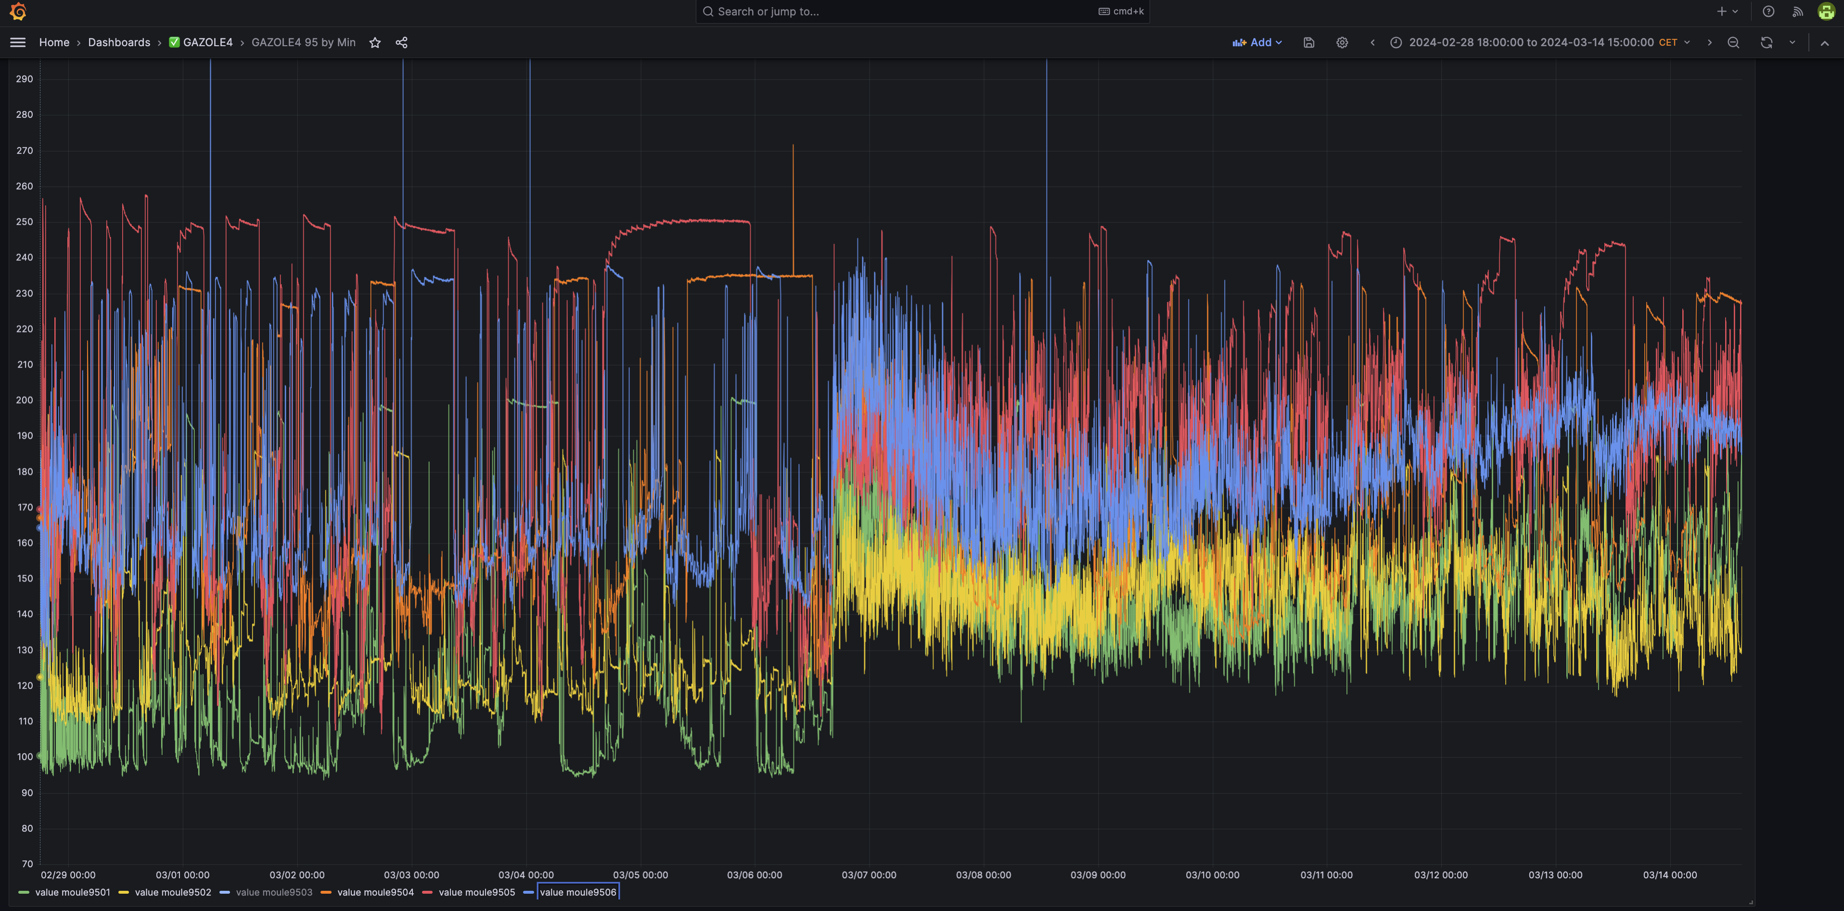
Data Analysis : Grafana visualization of Diesel effect (30 µL/L) ; superimposed raw valvometry of 5 mussels

Slide 12
Data Analysis : basic principles and extracted values
VOA (%)
Max opening
Filtration state
Closure
open
Opening
10 %
closed
Avoidance sate
Max closure
Time (sec)
Transition between states (avoidance/filtration)
Extracted values
Amplitude -> VOA (%)
Activity -> Valvebeat : Nb of openings = 4 ; Nb of closures = 4
Nb of transitions between states : avoidance <-> filtration = 5 (crossing the doted line)
Dwell time in states -> avoidance state (less than 10% VOA ; filtration state (> 10 % VOA)

Slide 13
Data analysis : exemple of strategy to detect rapid changes
Valvebeat in one Mytilus edulis in stabulation during 25 days with algae feeding
Opening and closure activity is counted in a 1-hour window browsing the time series in 30-minutes steps
Vavlebeats reduced or increased more than a certain threshold (set at 15 % here) compared to the preceeding step are spotted in red
- Signal
- moving average
- 15% increased
- 15% reduced
Dots : values diffreing from precedent
She expects to be fed ??
Daily feeding
Valvebeat (Nb/h)
Except WE
Period of stabilization (7 days)
Stabilization of valvebeat in 7 days after transplantation in tank
During Stabilization, valvebeat was high and variable, ranging from 7 to 27 /h
After stabilization, valvebeat stabilized at 2 /h
Each algae intake increased valvebeat at 5 to 15 /h

Slide 14
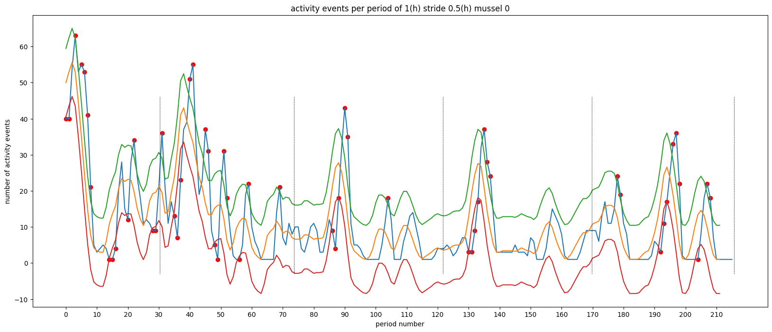
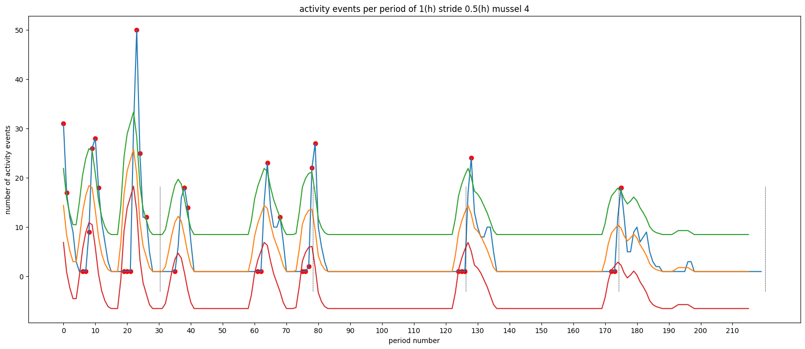
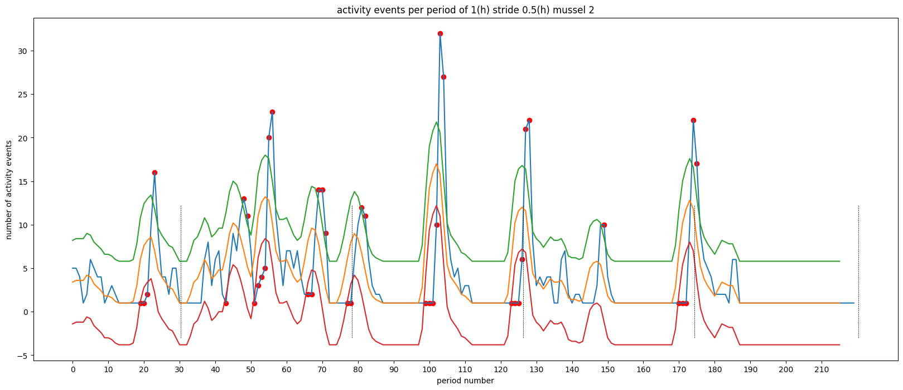
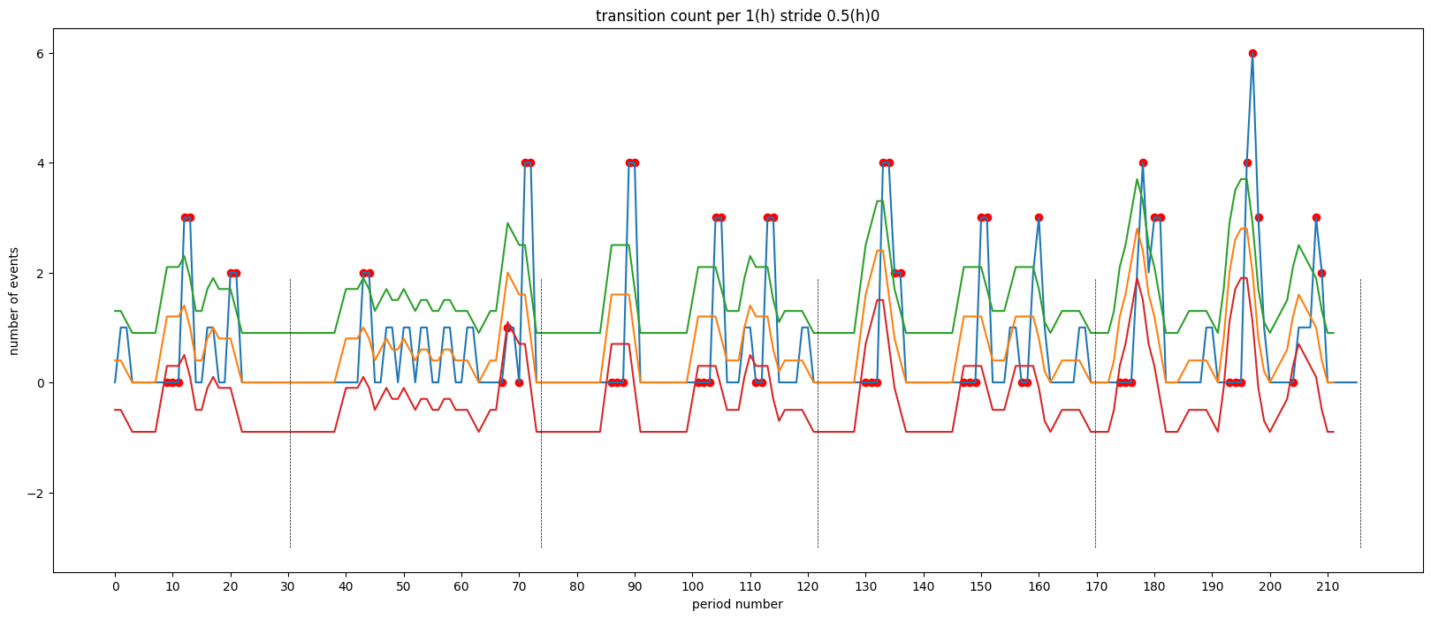
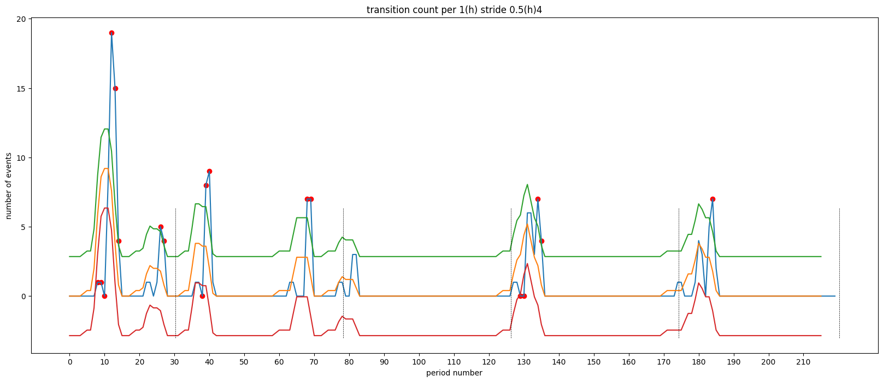
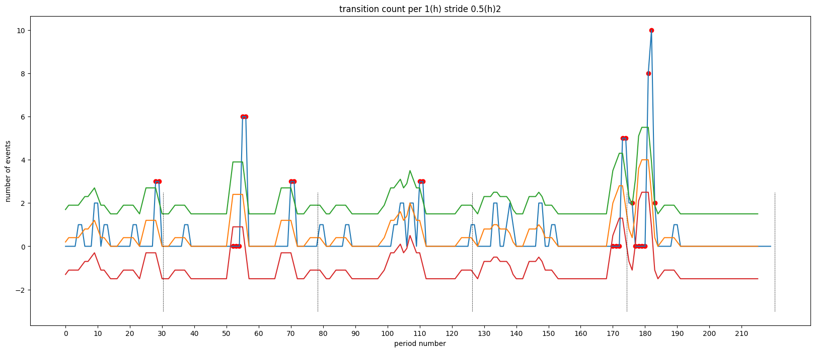
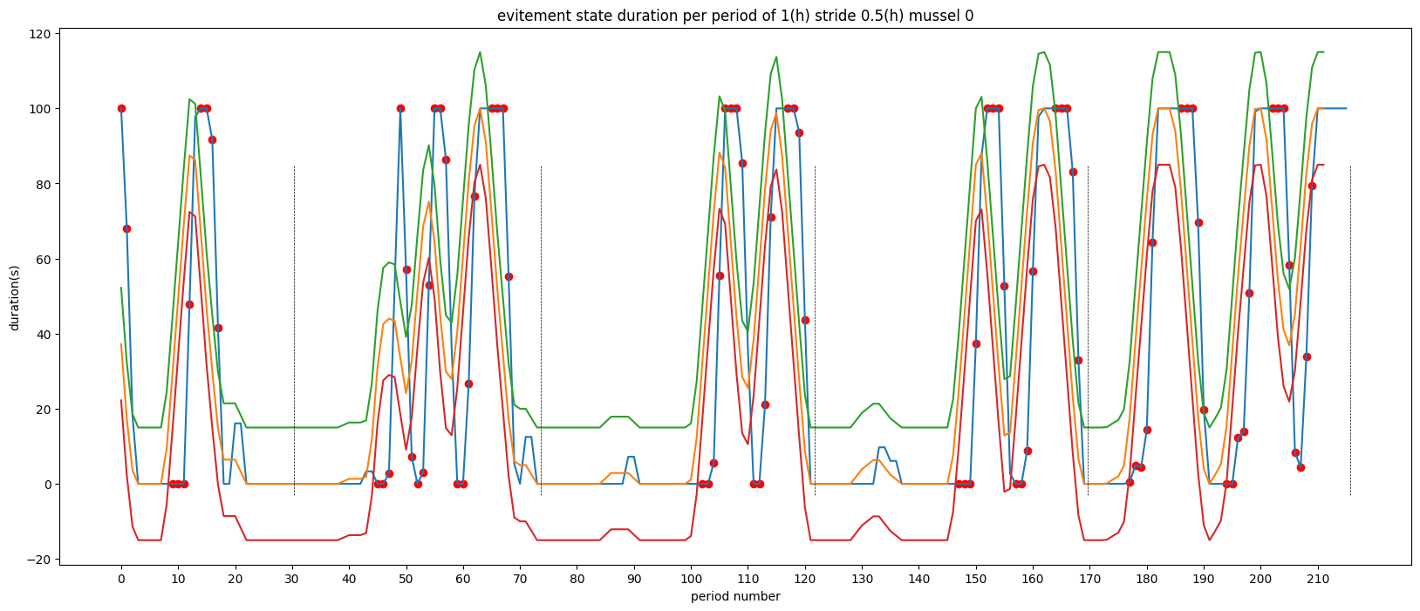
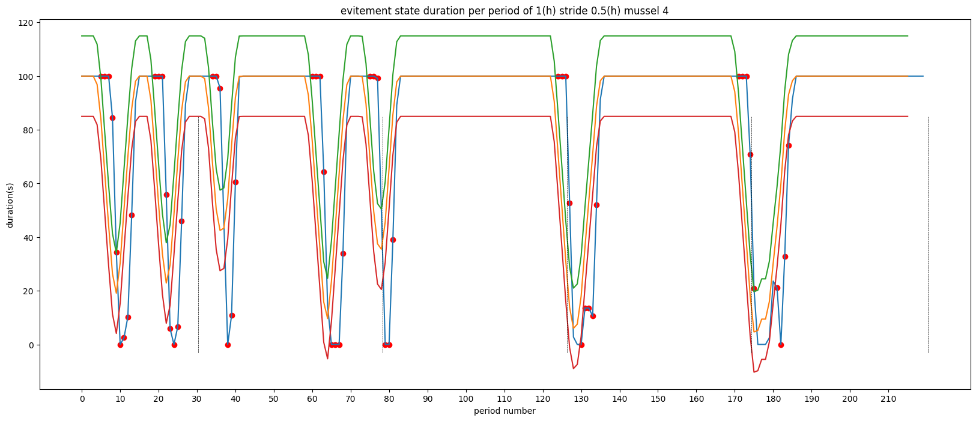
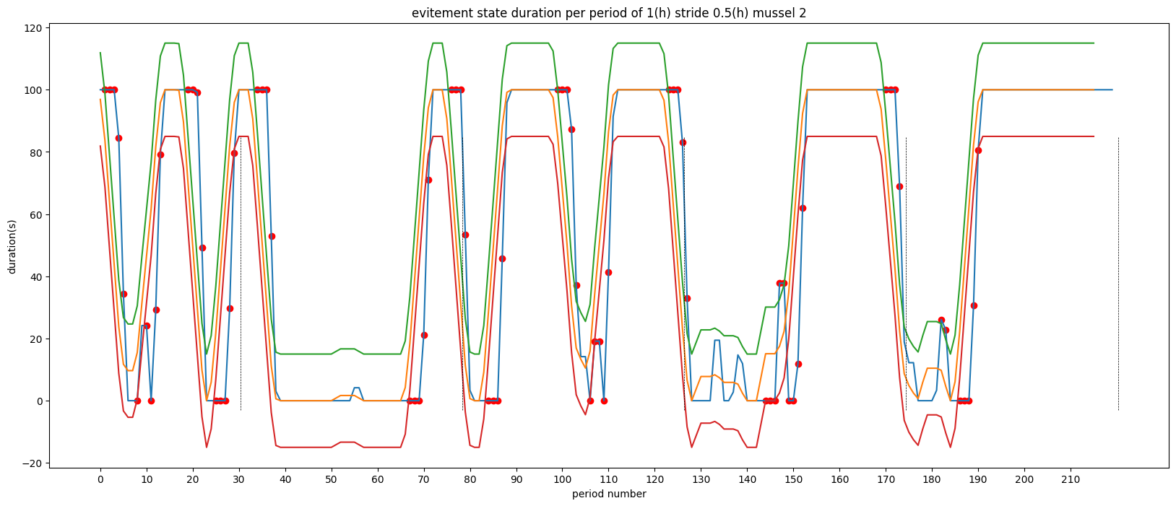
Dreissena fed with Hg-containing algae (10⁸ cell/24h/mussel)
CTRL
MMHG20
IHG20
Activity
Activity
Activity
Vavlvebeat /h
Transitions
Transitions
Transitions
Number /h
Avoidance
Avoidance
Avoidance
Times in closed state
Work in progress → selection of right analytic set up (window width and stride, threshold) and metric

Slide 15
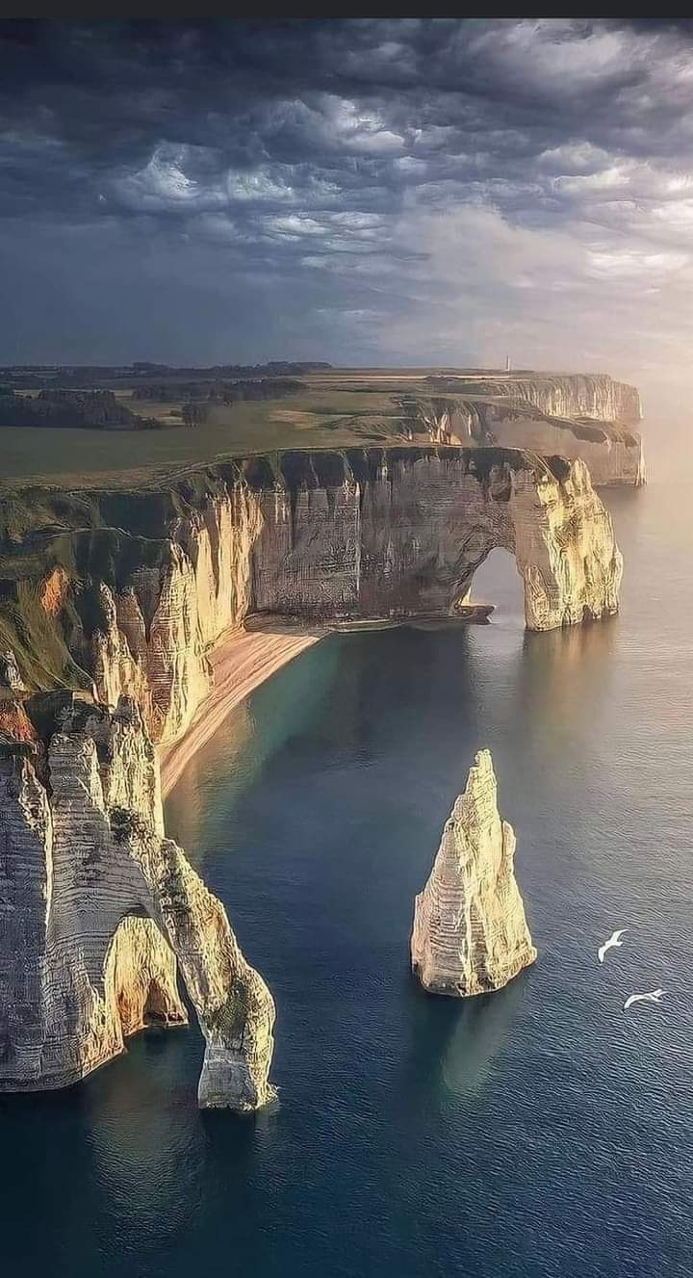
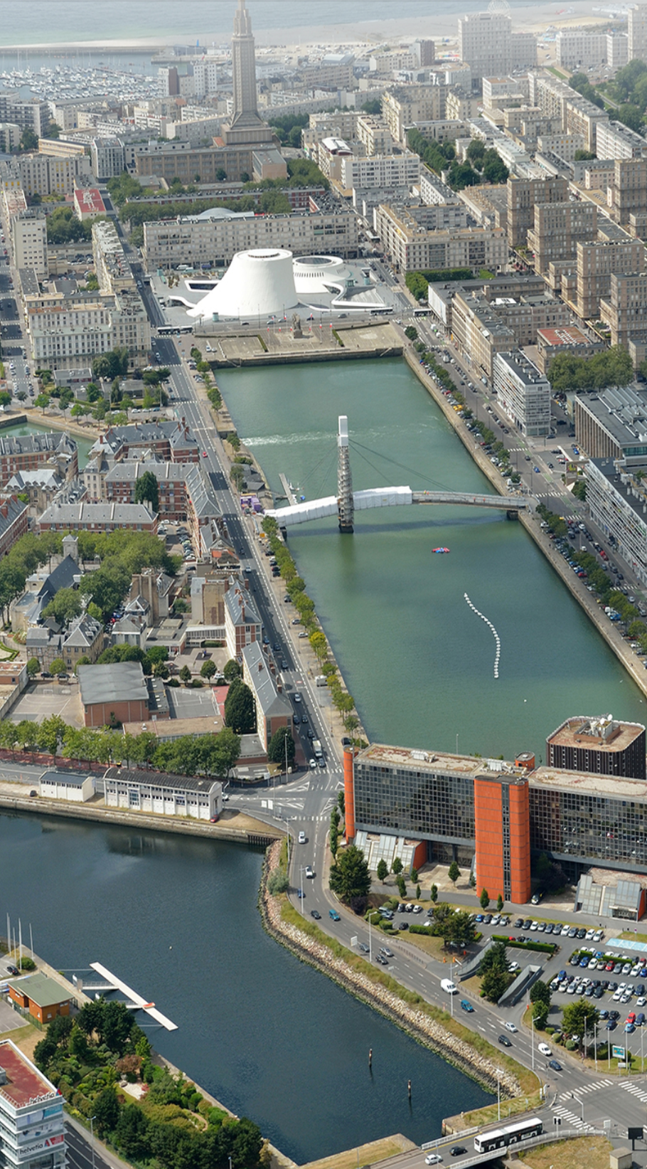

umr-sebio.fr
MERCI
OLIVIER Damien
TREMOLET Gauthier
BAUDRY Julien
PORET Agnès
SEGUIN Clarisse
FODIL Nour El Houda

